Slide 1


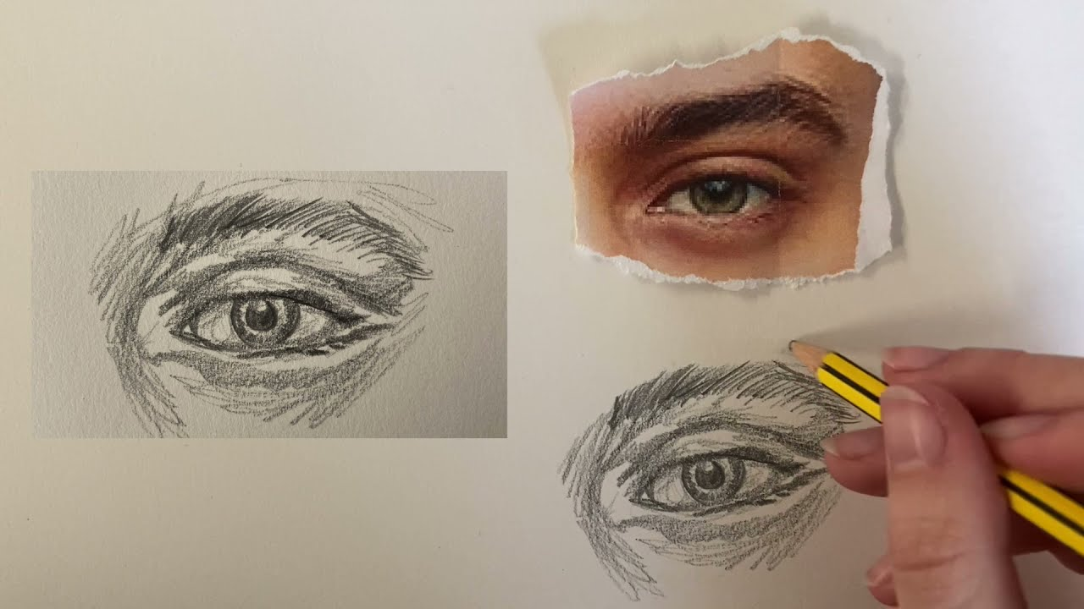
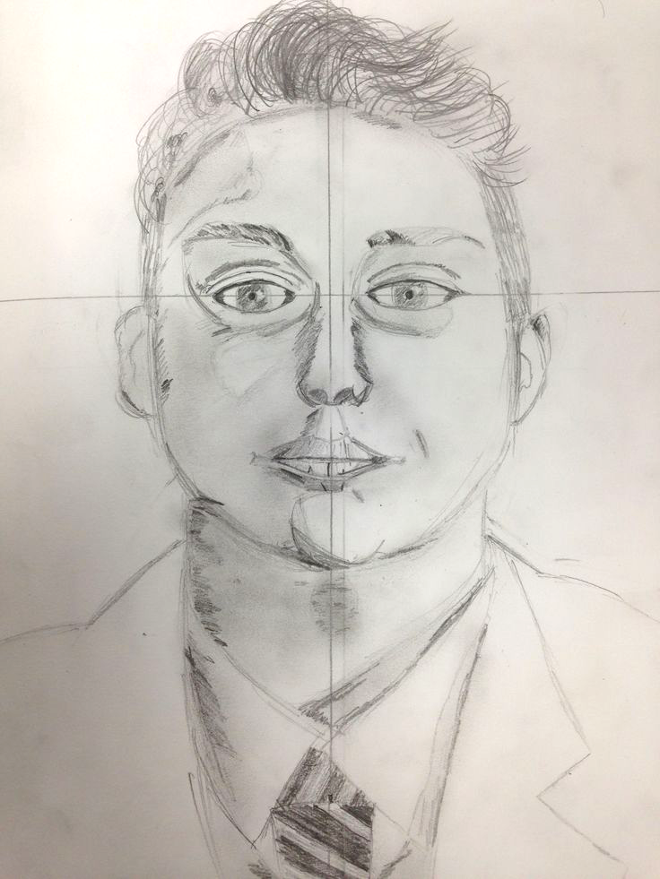
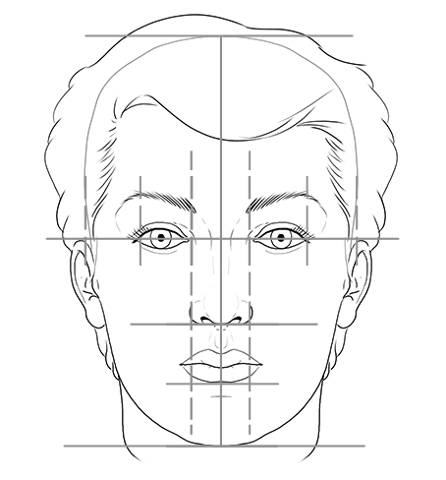
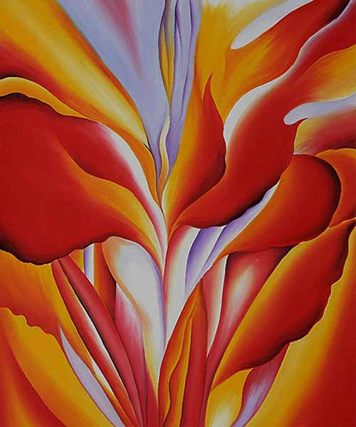

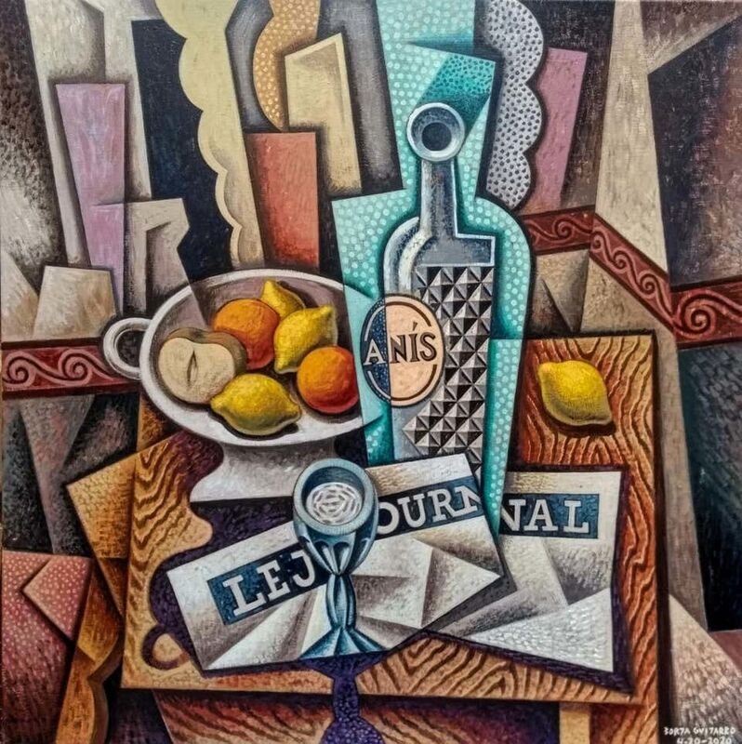
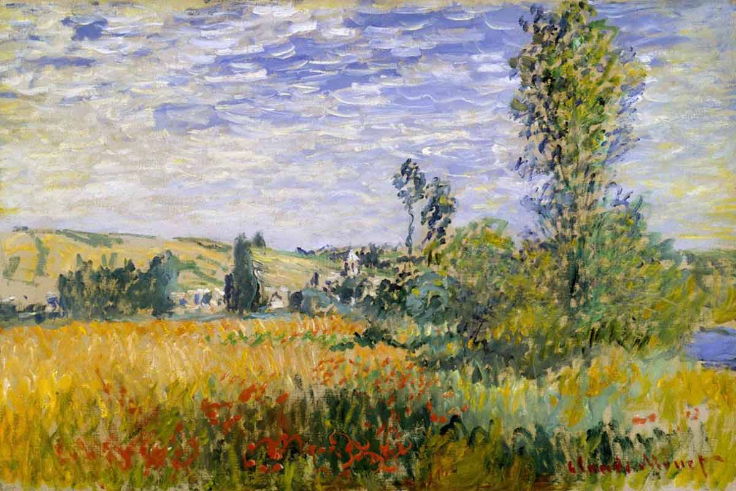
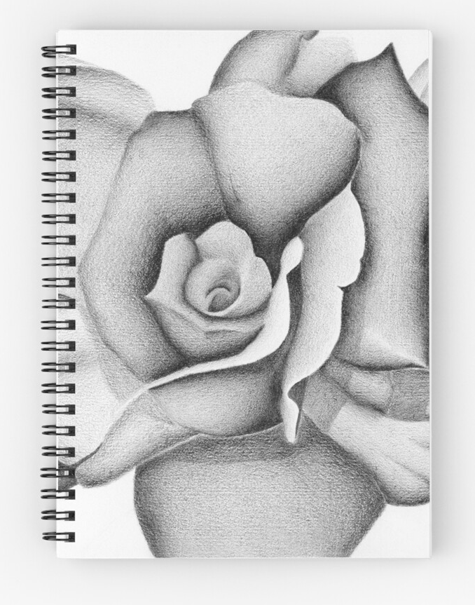
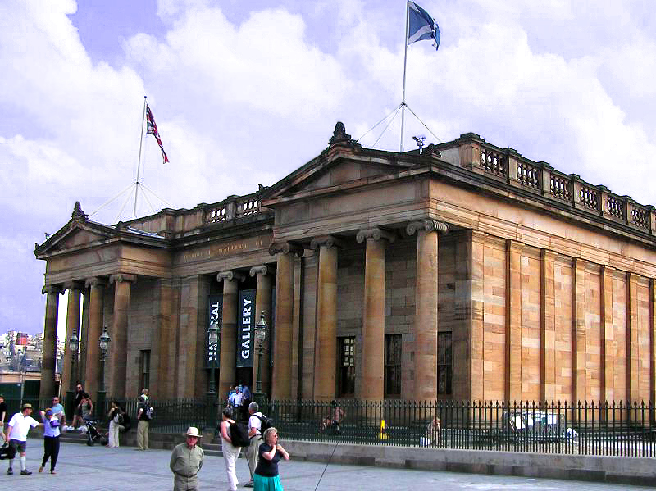

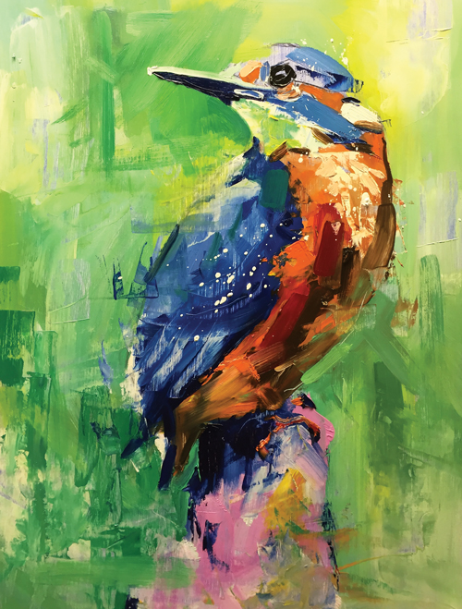
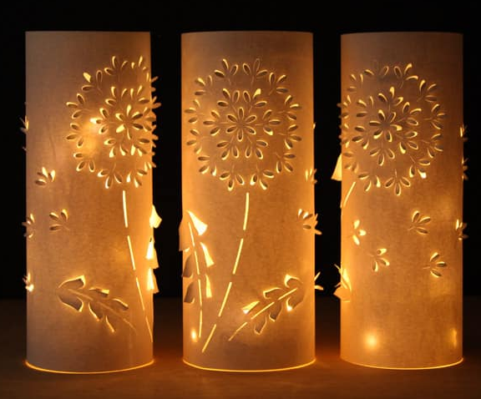
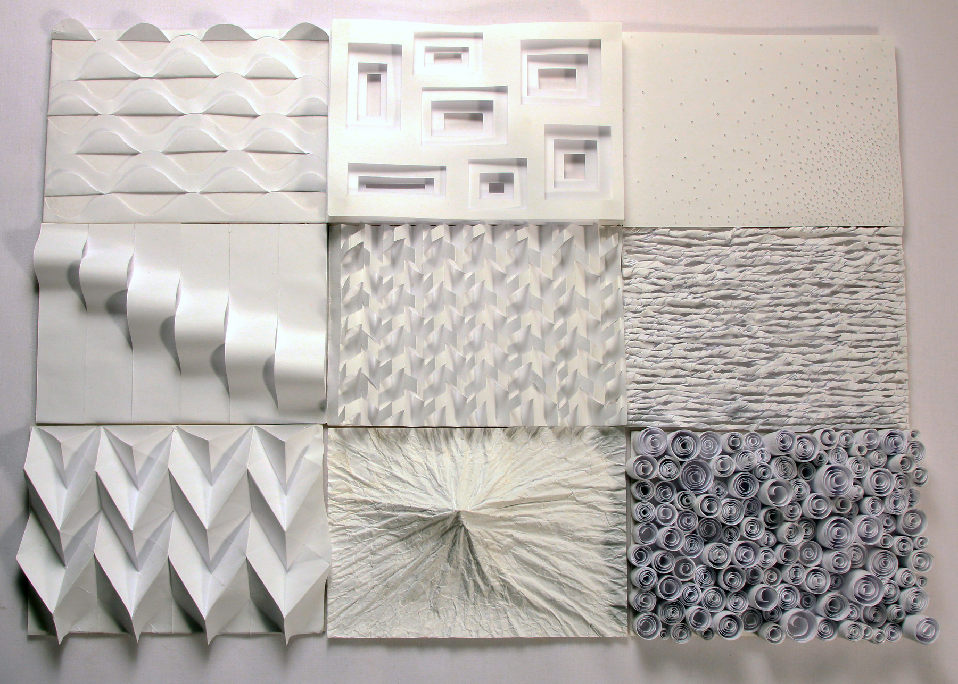
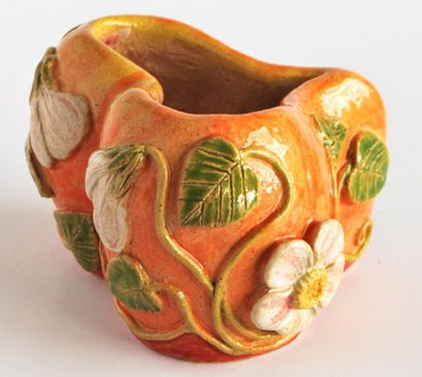
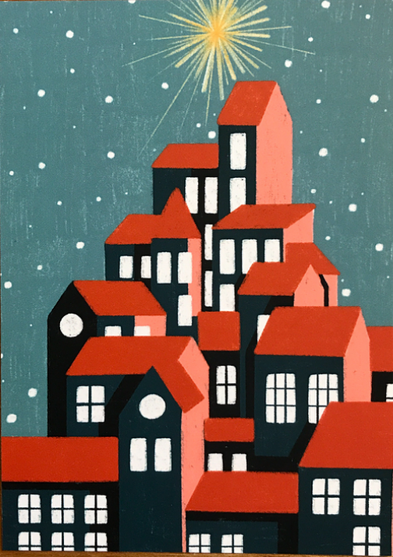

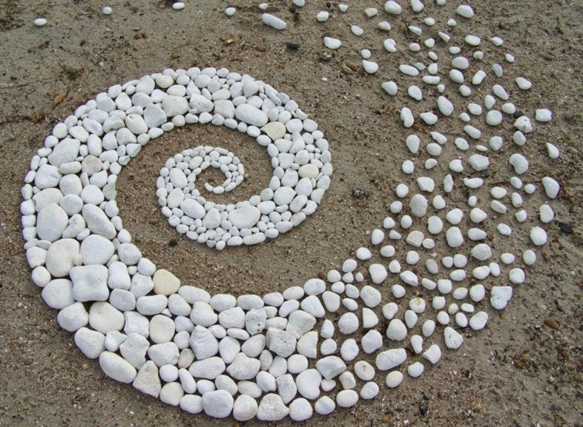
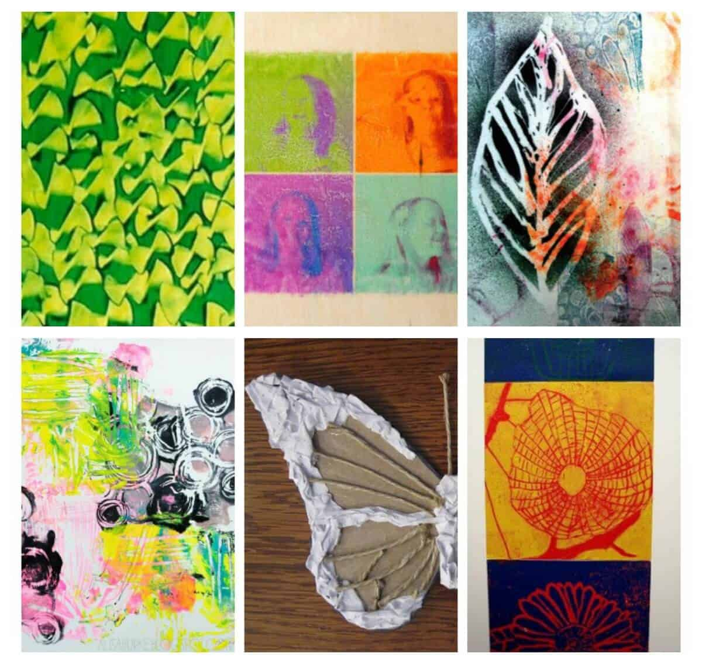
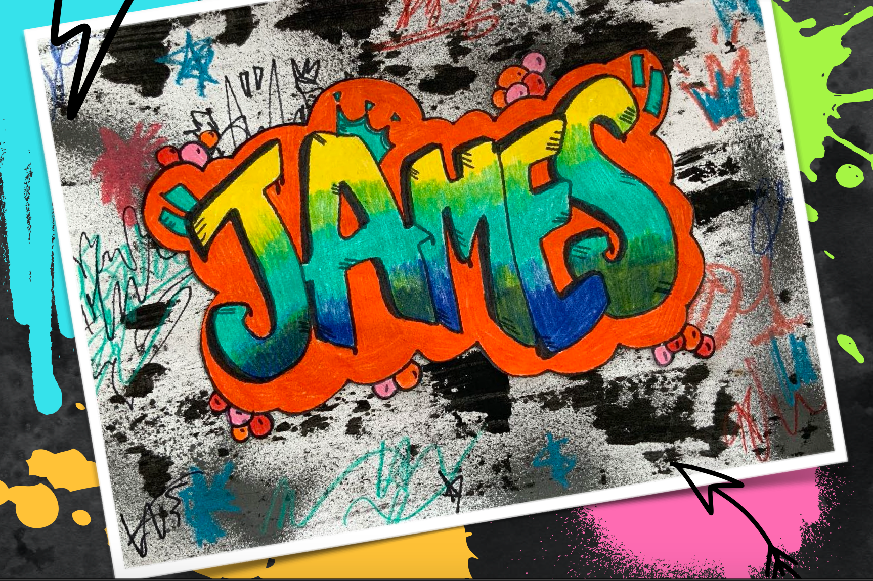

Our BGE ART learning journey at
Lockerbie Academy
Key Units and Assessments
Tonal Drawings of
Each Facial Feature
Create your own
Self Portrait
Georgia O’Keeffe
Inspired Painting
Nat.
READY!
Introduction to Self-Portraiture
Micro too Macro
Scaling Up
Drawing Exercises
Proportions of
the Face
Flower Power
Still Life Study
Inspired by Cubism
Landscape Studies Inspired
by Different Movements
History of Art
Folder
Cover
Intricate Flower
Study
Cubism
Fauvism
Realism and
Impressionism
S3
Introduction to
Mask Design
Design your
Own Mask
Drawing/Painting
of Art Brief
Masks of The World
National Gallery
Competition
Paper Mache
Mask Construction
Tonal Drawing –
Blending Techniques
Mask Research –
Coloured Pencil Study
Product
Design
Watercolour
Animal Painting
Black and White
Tonal Study
Introduction to
Portraiture
Light
Construction
3D Light
Design
Animal Magic
Folder
Cover
Paper
Manipulation
Perspective
Drawing
Griding
Techniques
Watercolour
Techniques
S2
Bottle Drawing-
Using Ellipses
Oil Pastel Composition
Working with a Design Brief
3D Ceramic’s –
Kate Malone
Mr. Asher’s Christmas Card Competition
Still Life
Ceramic Design
The
Christmas
Card
Colour Theory
Composition Tonal Drawing Test
Design
Terminology
Clay Pot
Construction
First-Hand Observational drawings
Natural Forms
The Visual elements
Introduction to Art
S1
Andy Goldsworthy
Homework
Art
Vocabulary
Exploring Different
Media
Shoe Drawing Homework
Graphic Design
Folder Covers
*Subject to
change

