Slide 1


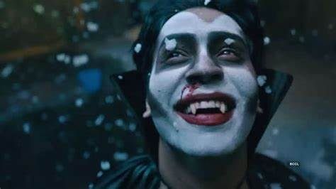







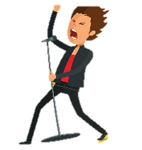

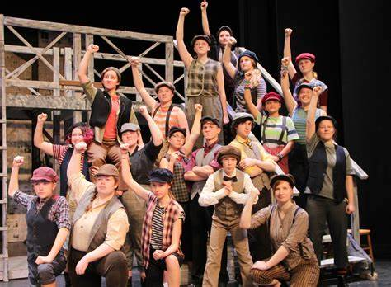

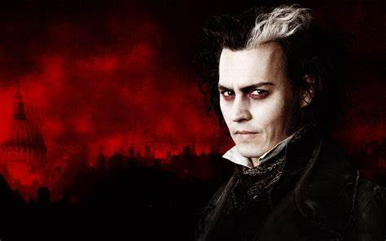


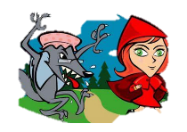
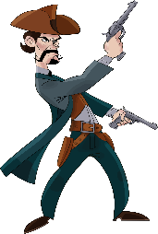
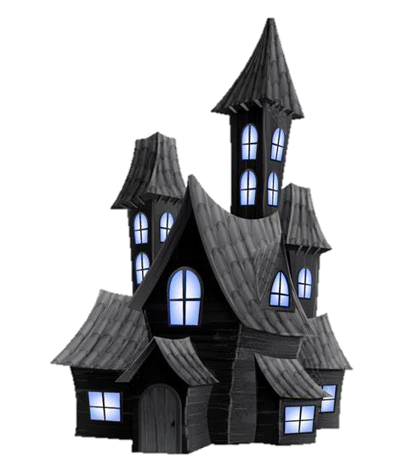


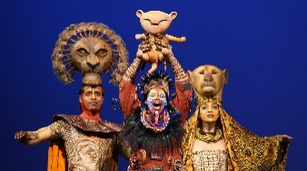


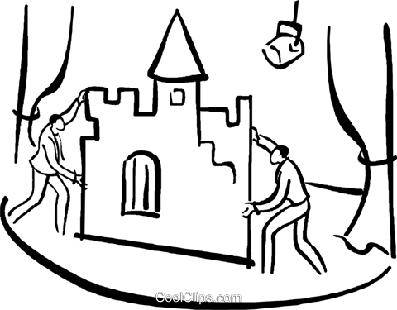

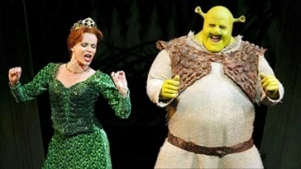



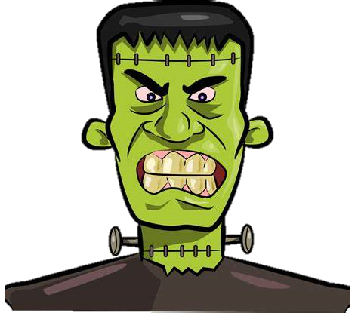
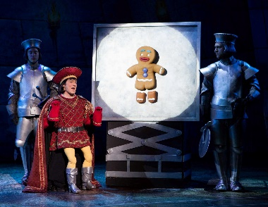
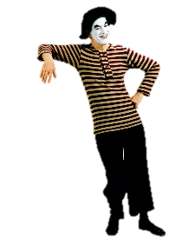


Our BGE drama learning journey at
Lockerbie Academy
Key performances and assessments
Dracula Spectacular
Blood Strangers OR
Blood Brothers
Literacy Assessment
Dracula Spectacular Performance
S3 Class Production 2
S3
Mini Production 3
Nat. READY!
Skill Choice
Performance Analysis: Grease: Live!
S3 Class Production 1
Skill Choice
Grease Performance
S3
Literacy Assessment
Sweeney Todd Performance
Newsies: The Musical
S2 Class Production
Little Red Hoodie
Peer Assessment
Performance Analysis
Script
Stage Combat
Wild West Performance
S2
The Lion King
Bugsy Malone Performance
Literacy Assessment
Creating Assessment
Darkwood
Production Skills
S1 Class Production
Slap, Dash and Bodgit
Performance Analysis
Mime
Introduction to Drama
S1
Induction
Shrek: The Musical
Frankenstein
Script
*Subject to change

