Slide 1
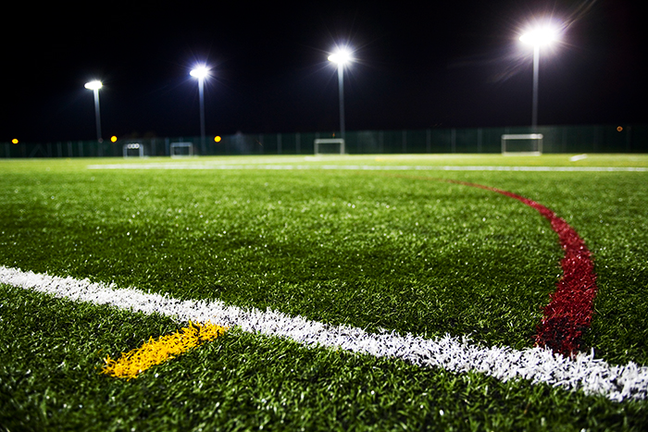

Lockerbie Academy
Sports Club Awards
2022-2023
Welcome

Slide 2

Meta Skills
Meta-skills are innate, timeless, higher-order skills that create adaptive learners; able to succeed whatever the future brings.

Slide 3


Slide 4
Lockerbie Academy
Sports Club Awards
2022-2023

Slide 5
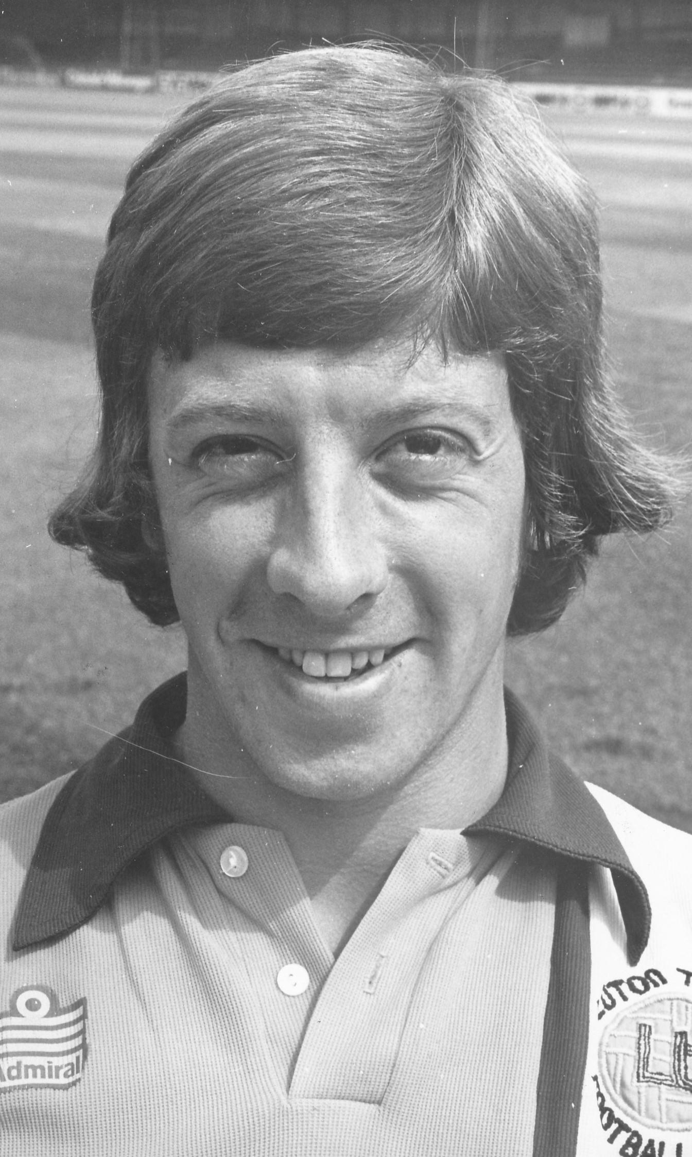
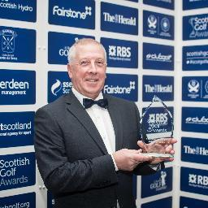
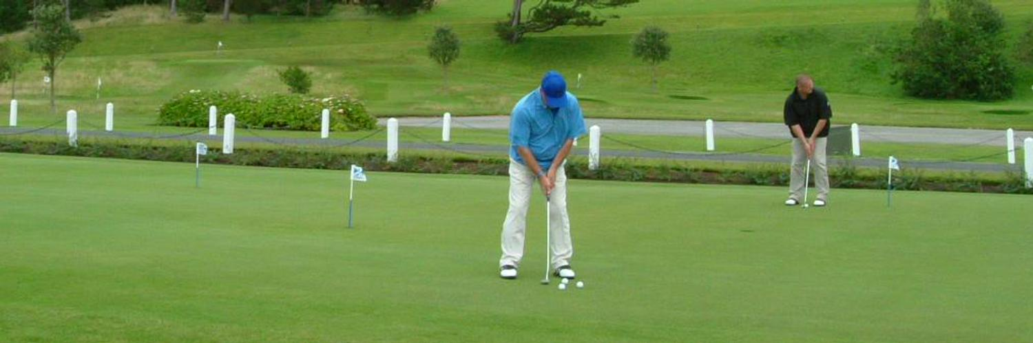
Maitland Pollock

Slide 6
Lockerbie Academy
Sports Club Awards
2022-2023

Slide 7
Parents/Carers: Who said?
“Some people think football is a matter of life and death. I don't like that attitude. I can assure them it is much more serious than that.”

Slide 8
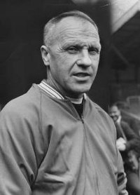
Bill Shankly

Slide 9
Lockerbie Academy
Sports Club Awards
2022-2023

Slide 10
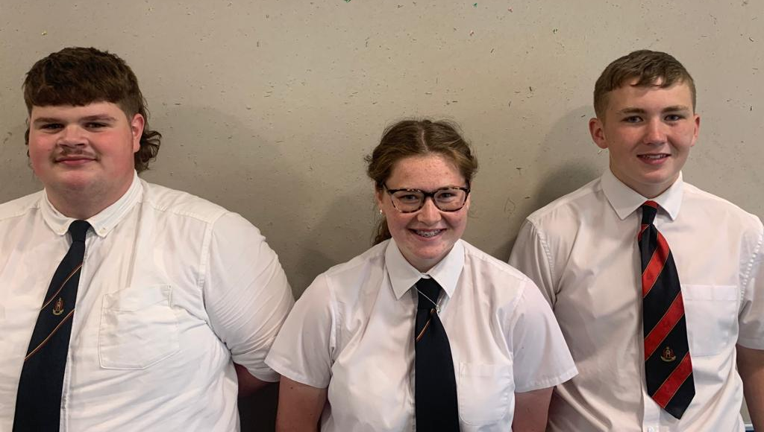
Sports Awards 2023 Presenters
Young Sports Ambassadors

Slide 11
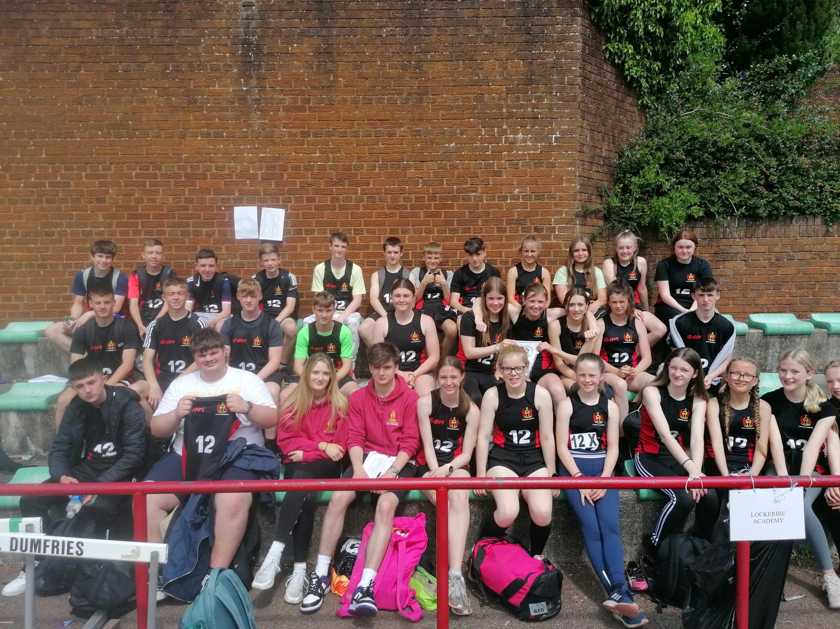
Athletics
Regional Athletics Results
S1 results
Holly McDowall – 3rd in 100m Final
Kady Sanger – 3rd in 800m Final
Kady Sanger, Brodie Lewis, Emma Sloan, Holly McDowall: 4x100m Relay – 2nd in 4x100m Relay Final
Alexander Arthur-McQueen, Reagan Walker, Crawford Watson, Lewis White – 2nd in 4x100m Relay Final
S2 Results
Jonathan Brandt – 3rd in 100m Final, 3rd in 400m Final

Slide 12
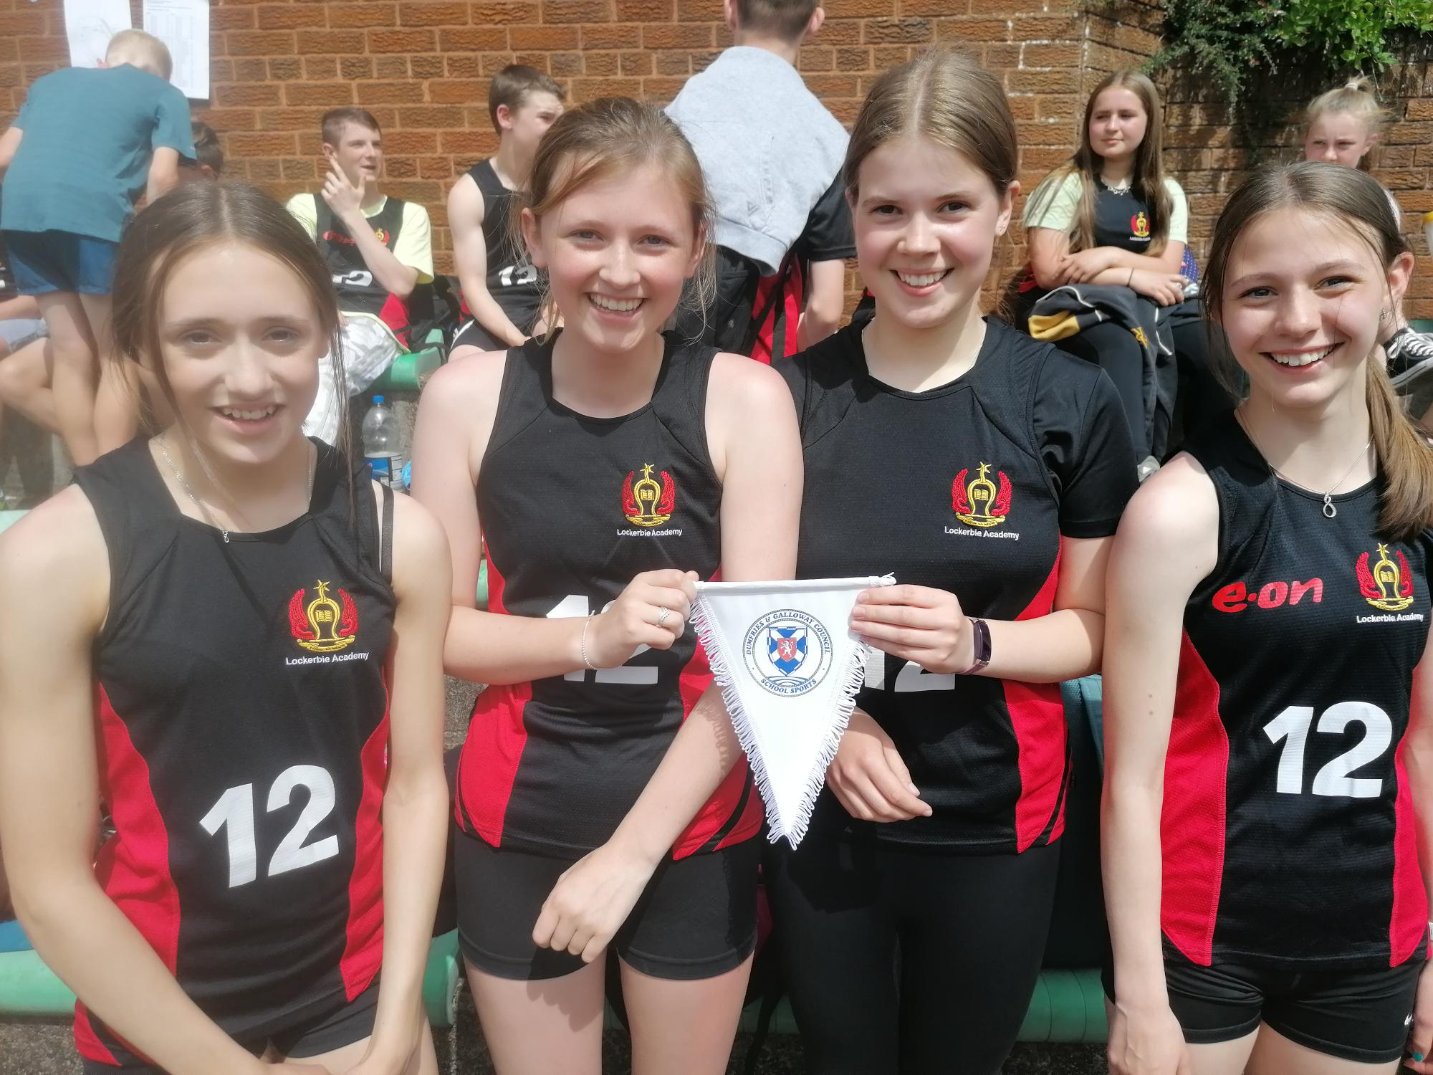
Athletics
Regional Athletics Results
S3 Results
Anna Reid – 1st in 100m Final
Kayla Dinnin – 1st in 800m Final
Imogen Spence – 2nd in Discus Final
Kash Nichol – 2nd in 100m Final
Kyran Wade – 2nd in Discus Final and 3rd in Shot Putt Final
Felicity Jackson, Kate Thomson, Madison Hamill, Anna Reid – 1st in 4x100m Relay Final
Harry Collins, Lennon Kerr, Callum Hill, Kash Nichol – 2nd in 4x100m Relay
Senior Results
Tristan Woolley – 3rd in Shot Putt Final, 3rd in Discus Final

Slide 13
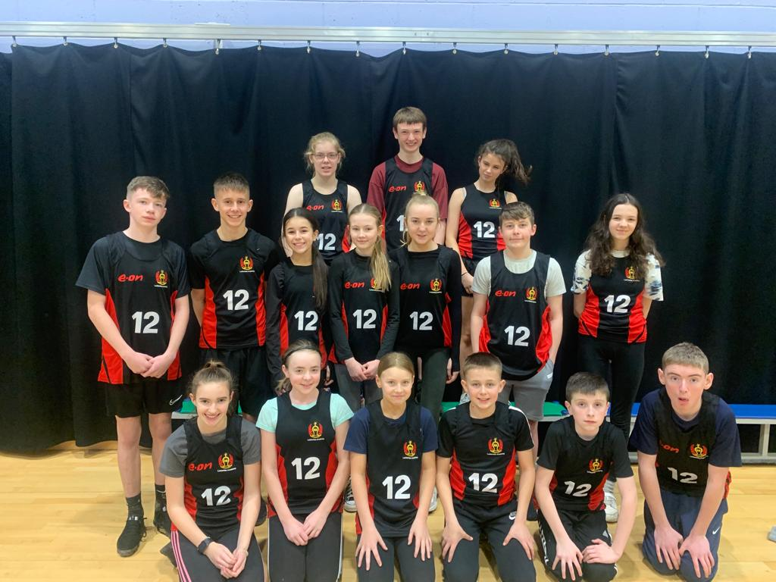
Cross Country
Regional Cross Country Results
Individual highlights:
Kayla Dinnin (S4) – 1st & Regional Champion
Thomas Boyes (S3) – 2nd
Iona Yule (S3) - 3rd

Slide 14
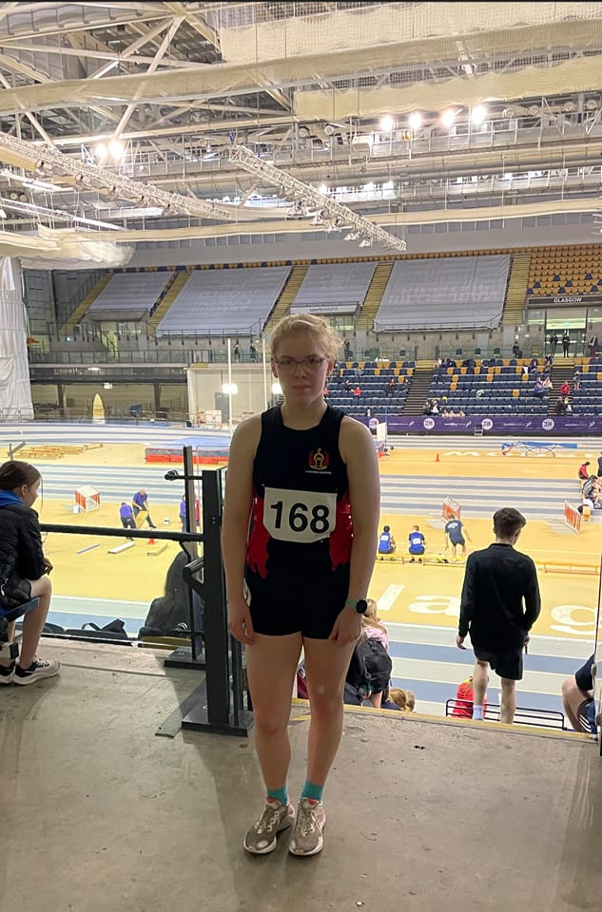
Kayla Dinnin
Highlights:
Athletics
Regional Schools 800m and Cross Country Champion
Selected and represented West of Scotland
Top 20 finishes in National XC, Scottish Schools Road Race and Indoor events.
Aquathlon
1st in Scotland for S3 at Scottish Schools Aquathlon
Triathlon
3rd in Youth A category at Scottish Championships with the fastest bike split
16th at World Triathlon Series in Leeds
Reserve for Scotland at the UK School Games

Slide 15
S3 (NOW S4) 4x100m - Team of the year shortlisted
Felicity Jackson, Kate Thomson, Madison Hamill, Anna Reid –1st / Regional Champions

Slide 16
Lockerbie Academy
Sports Club Awards
2022-2023

Slide 17
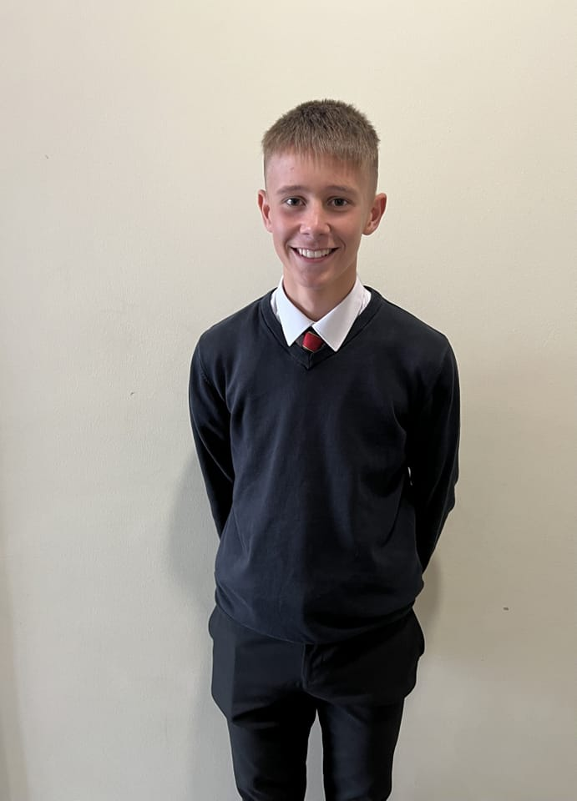
Golf
Isaac Scott - 12 handicap
South of Scotland U14 squad
Tied 1st in Titleist National Pairs with Adam in Portugal
Handicap
Ben Carmichael 2.1
Charlie Maxwell 6
Duncan Kingsley 14

Slide 18
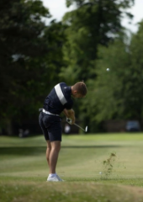
Adam Scott
Highlights
Handicap is +1
America Scholarship in August 2024 for 4 years
Top 20 U18 ranked golfer in Scotland
South of Scotland Team captain
Sponsorship of Stephen Gallagher and Titleist

Slide 19
Lockerbie Academy
Sports Club Awards
2022-2023

Slide 20
S1 Presentation

Slide 21
Lockerbie Academy
Sports Club Awards
2022-2023

Slide 22
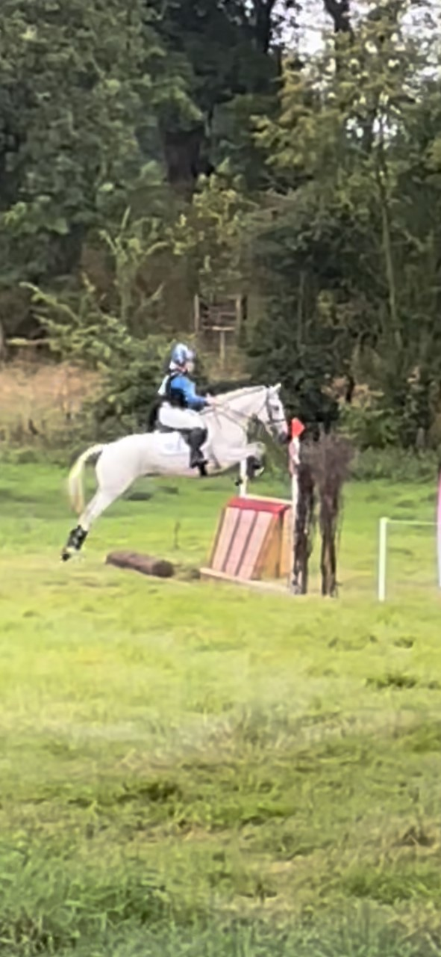
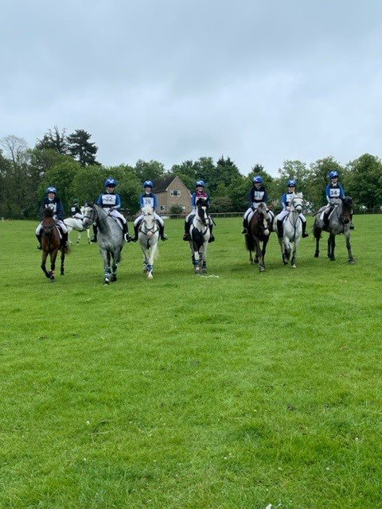
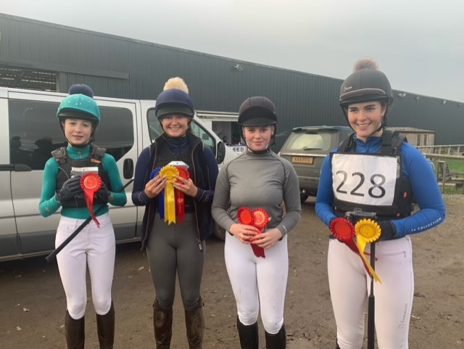
NSEA/Show Jumping
NSEA TEAM ATTENDING Hickstead -
Team of the year shortlisted

Slide 23
Kiera Graham
Highlights
British show jumping newcomer 1.10 1st
Qualified for British show jumping members cup 1.15m
Aintree equestrian British show jumping – 3rd 1.15
Completed NPA's in yard routines at level 4 & 5
Works at Ian Jardine Racing to gain experience on a professional yard

Slide 24
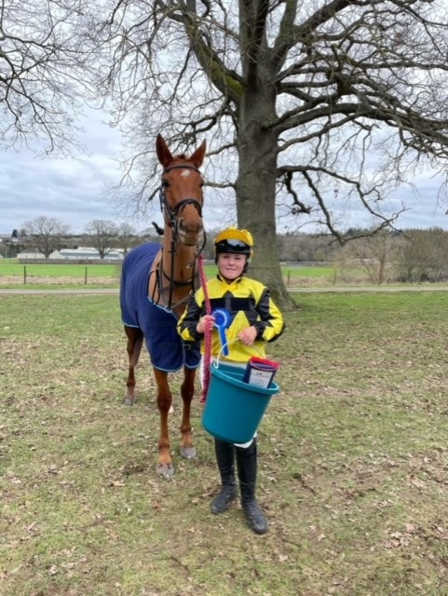
Tara Kane
Highlights
Qualified to attend NSEA Hickstead
Qualified to attend the Royal Highland show = 2nd place finish
Selected to represent Scotland BE team at Bishop Burton
Selected to represent Scotland at UK championships at Warwickshire
British shooting championships
Part of the school rugby team who won recent school's competition

Slide 25
Lockerbie Academy
Sports Club Awards
2022-2023

Slide 26
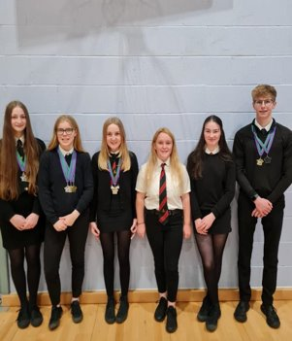
Swimming
Regional Schools Championships Results
Kayla Dinnin
silver 15-16 200m freestyle
silver 15-16 200m IM
bronze 15-16 100m freestyle
bronze 15-16 400m freestyle
Carly Black
silver 13-14 200m backstroke
bronze 13-14 200m IM
bronze 13-14 400m freestyle
Catherine Adkins -
silver 15-16 100m breaststroke
silver 15-16 200m breaststroke
Finn Patterson
gold 17-19 200m breaststroke
silver 17-19 100m freestyle
silver 17-19 200m IM

Slide 27
Lockerbie Academy
Sports Club Awards
2022-2023

Slide 28
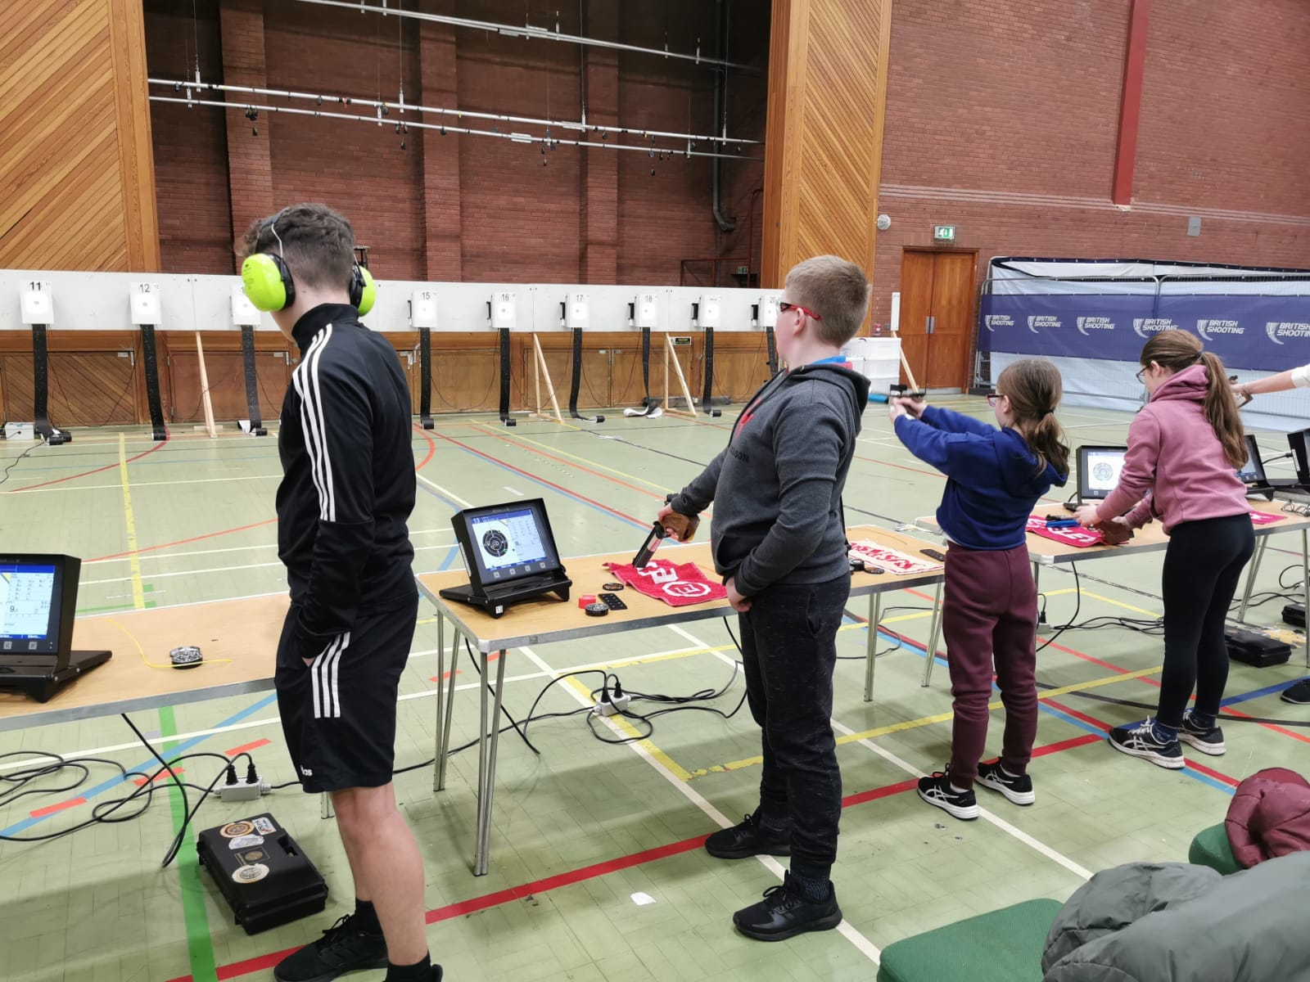
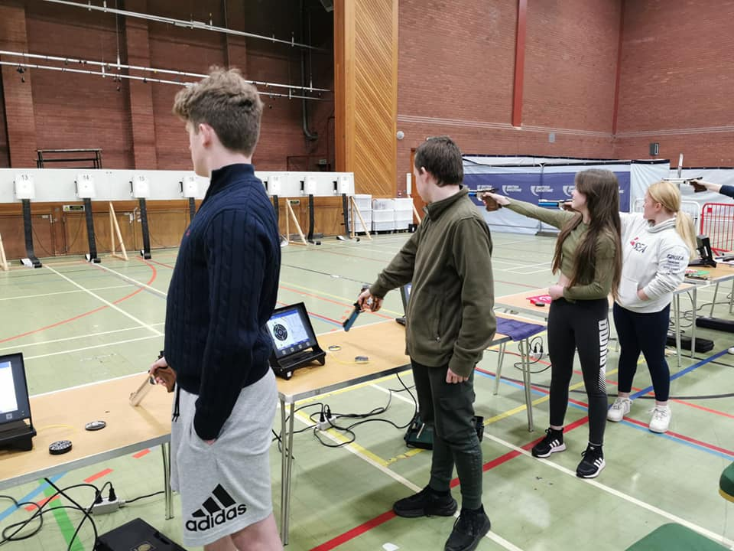
Team of the year shortlisted
Pistol Shooting
Most improved – Brodie Lewis
Most improved - Jake McKill
Intermediate Performance Award – Jack Edgar
Performance Award – Finlay Moffat

Slide 29
Lockerbie Academy
Sports Club Awards
2022-2023

Slide 30
S2 Presentation

Slide 31
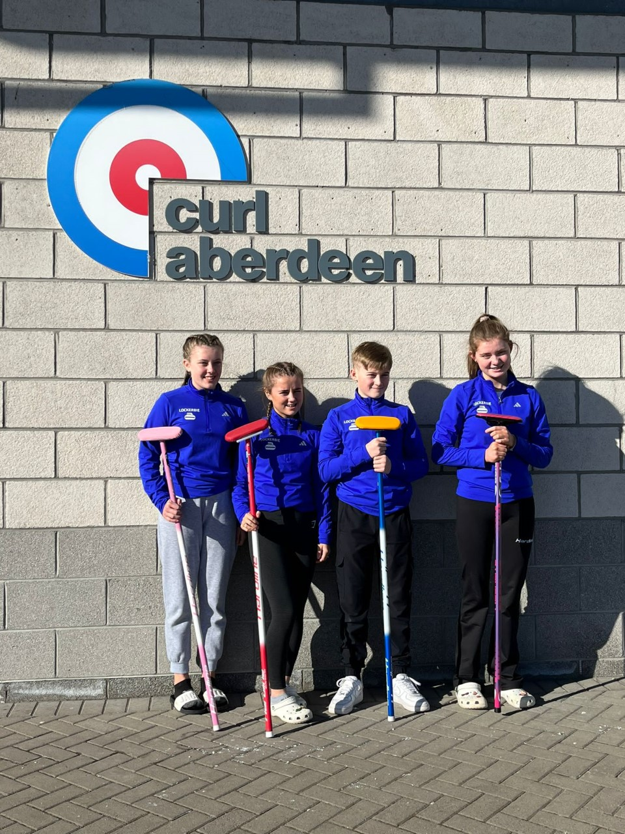
Curling
2 teams represented Lockerbie Academy this year.
Scottish Schools Team
Gregor Bell
Yvie Stewart
Amelia Cameron
Connie Black
The Andrew McClune bonspiel team
Jamie Gall
Hayden Whitelaw
Robert Hastings
Lewis Pattulo
Alasdair Rogerson

Slide 32
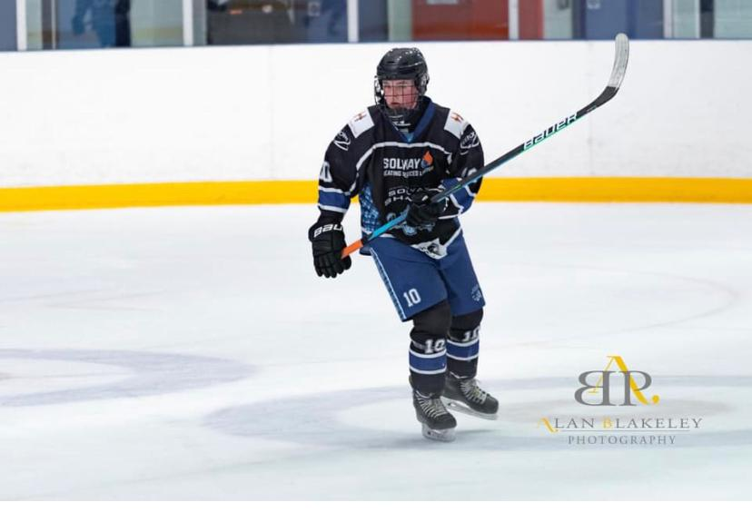
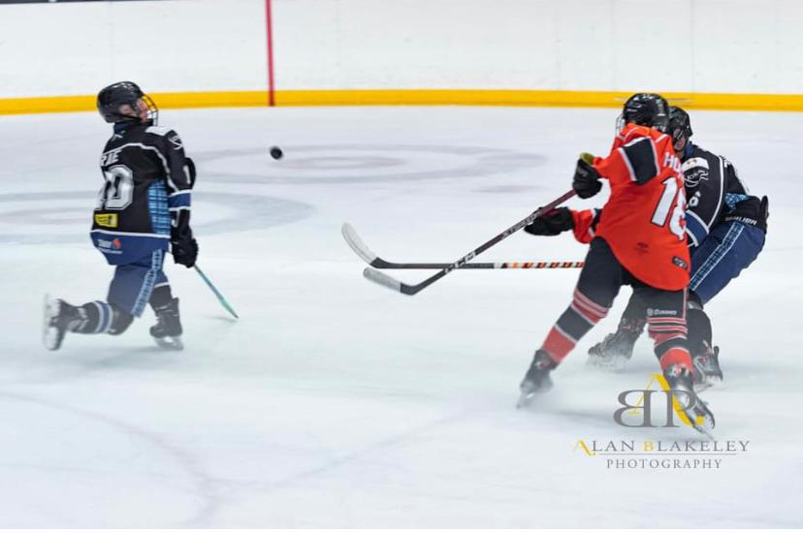
Owen Rae: Ice Hockey
Highlights
Solway Sharks in Dumfries
U16 league champions
Selected for Scotland U16s, competing in Bratislava
Selected to represent GB U15s
Trialled for GB U16s

Slide 33
Lockerbie Academy
Sports Club Awards
2022-2023

Slide 34
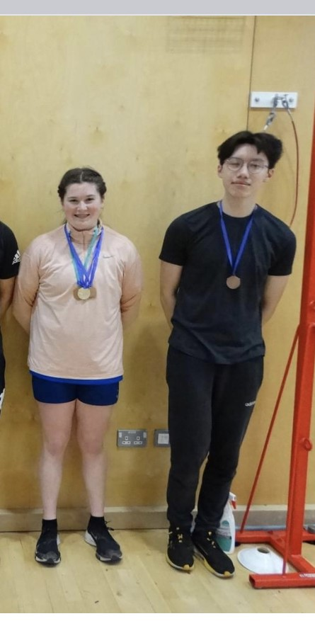
Badminton
U19 Regional Schools Badminton
Anna Newbould – 3rd Singles
Anna Newbould and Harry Turner – 3rd Mixed Doubles

Slide 35
Lockerbie Academy
Sports Club Awards
2022-2023

Slide 36
S3 Presentation

Slide 37
Lockerbie Academy
Sports Club Awards
2022-2023

Slide 38
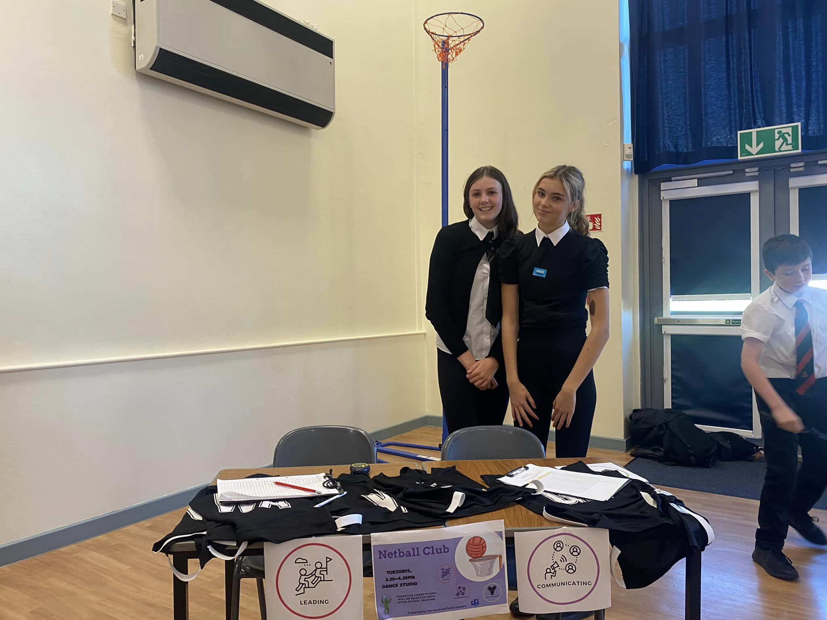
Netball
Tuesdays in Games Hall, led by Alice Couper and Jess Forster.
Unfortunately, the Senior season openers for this year were cancelled, but the club has still been successful.
Alice & Jess both trialled and were successful in making the Regional Schools Netball team again this year!
Notes:
Next it was the turn of the Senior boys some who had never played hockey but stepped up to represent the school, with the boys finishing in a respectable 3rd place.
Later on in the year the S1 & S2 girls tournament took place and the girls were up against tough competition. The S1 girls got off to a flying start and ended up in the final, finishing runners up in the tournament. The S2 girls fought hard throughout and finished a respectable 7th.
Finally, the S1/2 boys team took part in their first competiition. The boys again took their round robin by storm with some excellent saves from their goalie Jake Vaughn to help them get into the finals against Wallace Hall. Sadly the boys were beaten on goal difference but finished runners up in the tournament.

Slide 39
Lockerbie Academy
Sports Club Awards
2022-2023

Slide 40
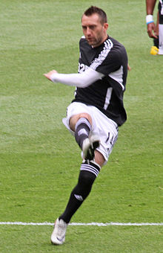
Who is this?
Notes:
Steven Dobbie

Slide 41
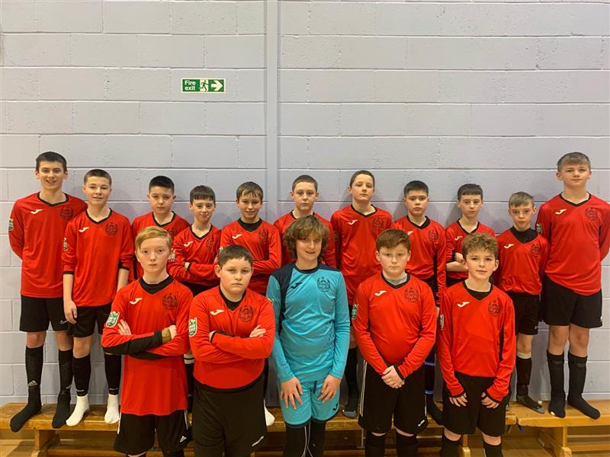
Football – U13’s
Cup semi finalists

Slide 42
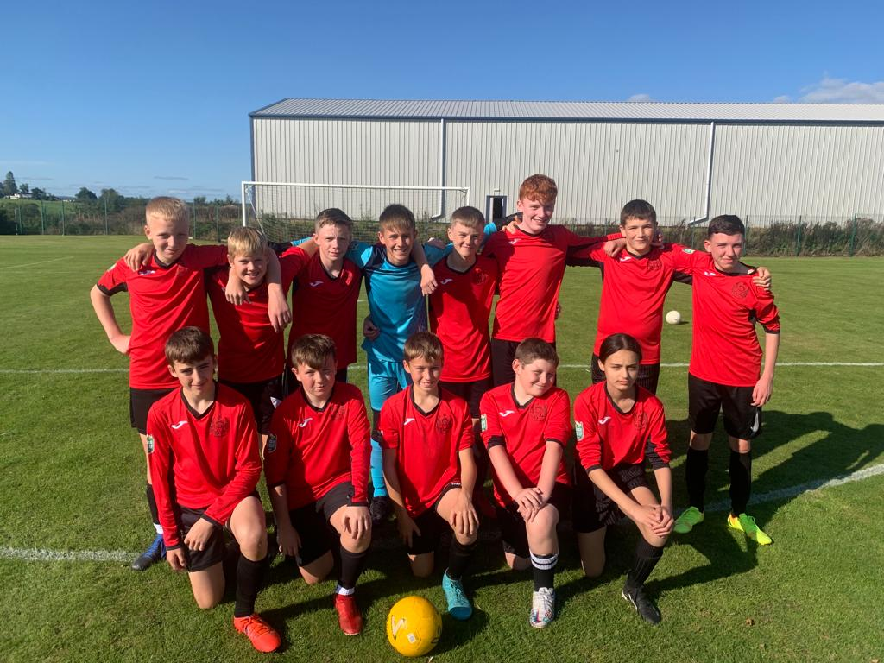
Football U14’s

Slide 43
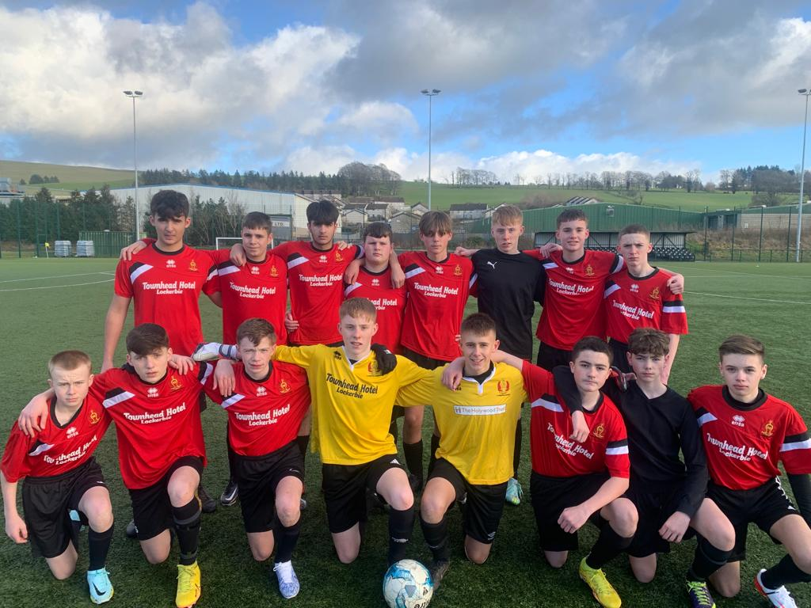
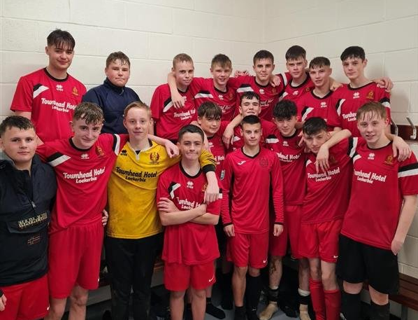
Football - U15, U16s & U18’s
15s Results – Hunter Shield
Semi finalists
U18s results
Win against Dumfries Academy
Semi-final JH Lorraine Trophy played this morning
U16s results
Undefeated in the league
Lockerbie Academy 6-4 Annan Academy
Dumfries Academy 1-2 Lockerbie Academy
Lockerbie Academy 3-0 Stranraer Academy
Lockerbie Academy 8-0 Wallace Hall Academy

Slide 44
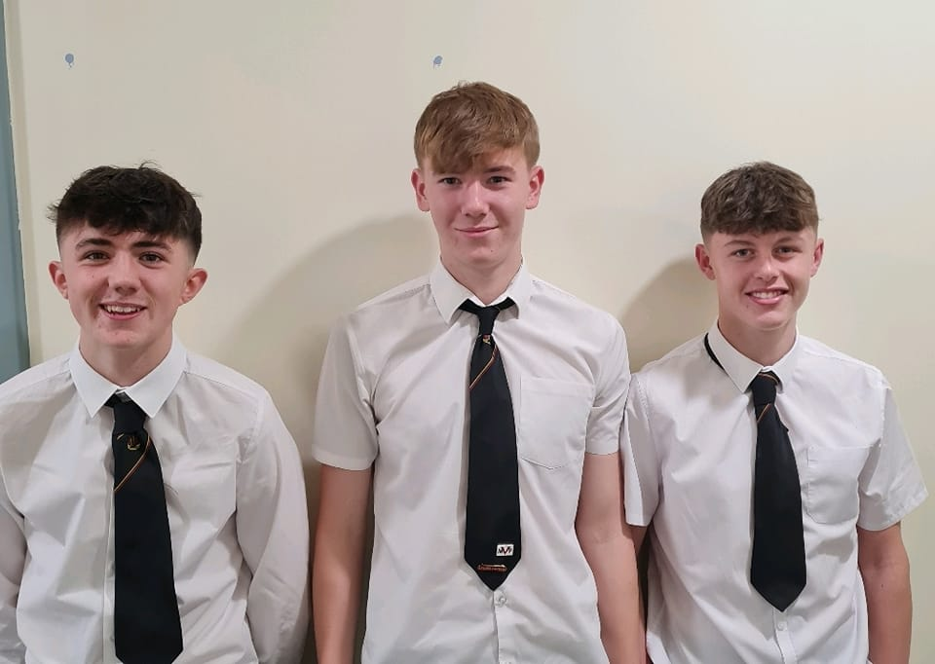
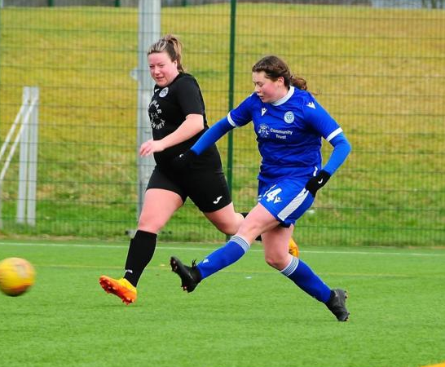
REGIONAL FOOTBALLERS
Callum Hill, Tom Forster and Charlie Maxwell all successfully trialled for the Senior Dumfries & Galloway Schools Football team.
Anna Newbould made the Senior Girls Dumfries & Galloway Schools Football team.

Slide 45
Player of the Year

Slide 46
U16 Football – Team of the year shortlisted

Slide 47
Lockerbie Academy
Sports Club Awards
2022-2023

Slide 48
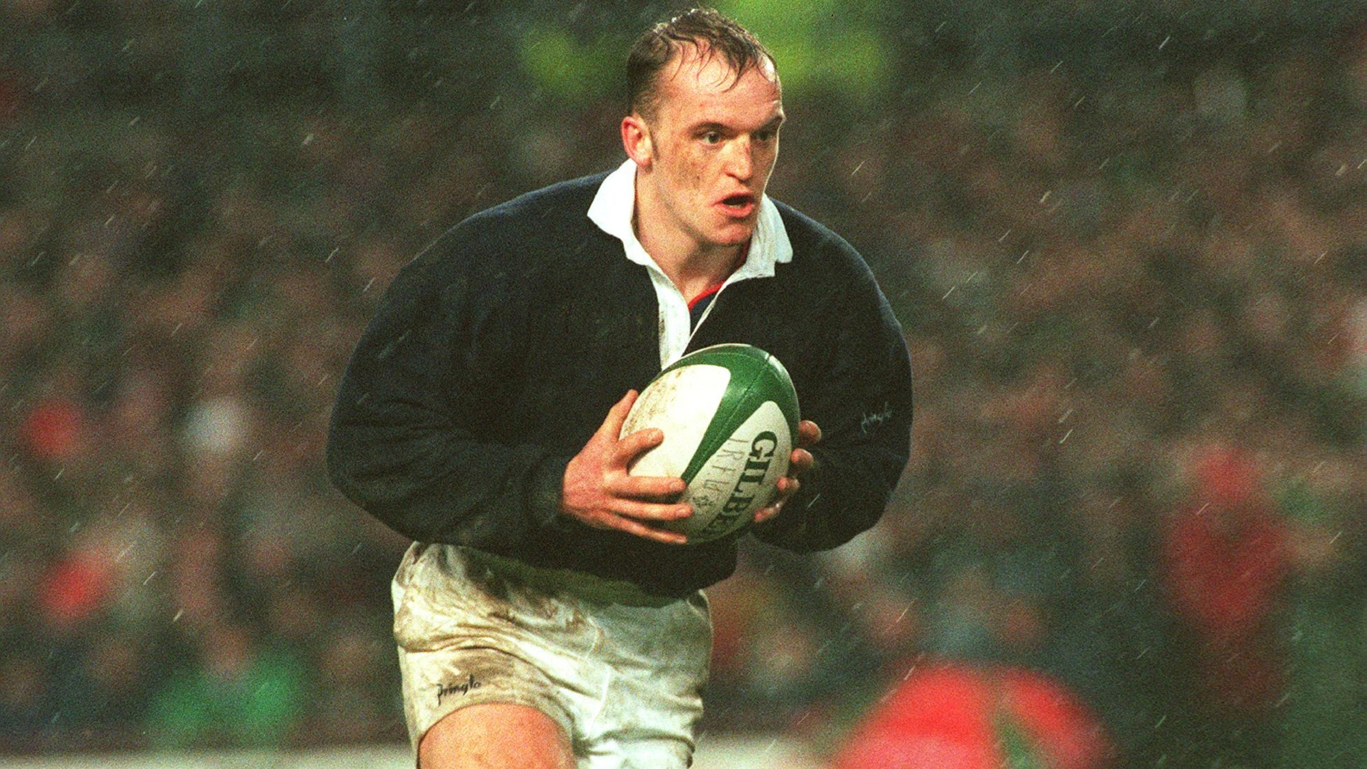
Who is this?
Notes:
Drew McIntyre - The Scottish Psychopath

Slide 49
Rugby

Slide 50
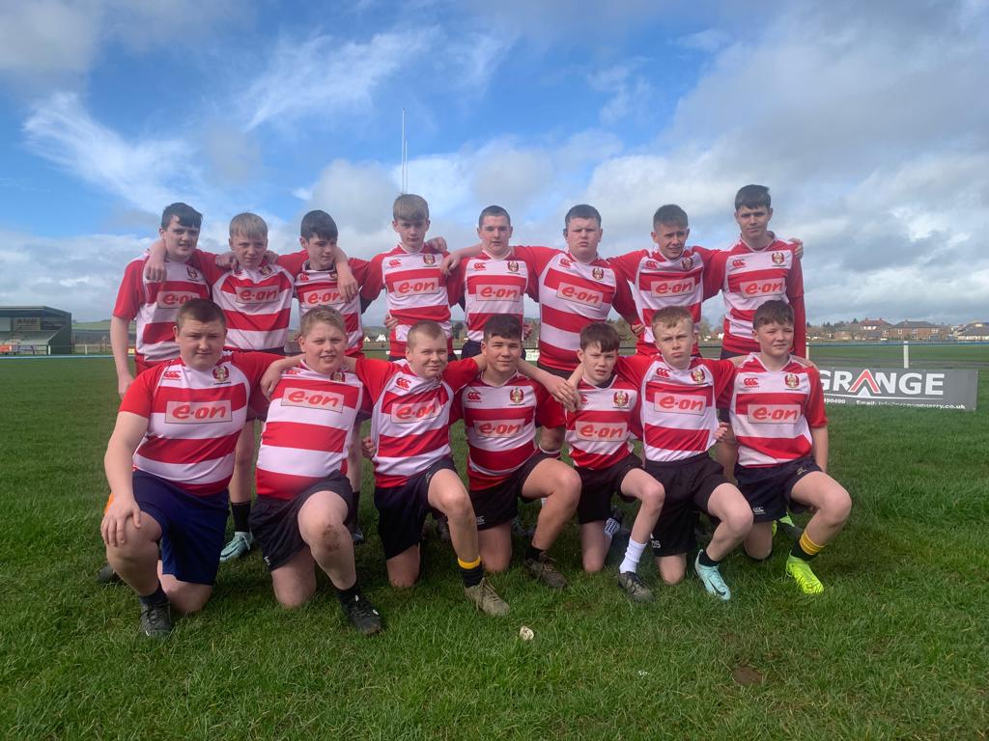
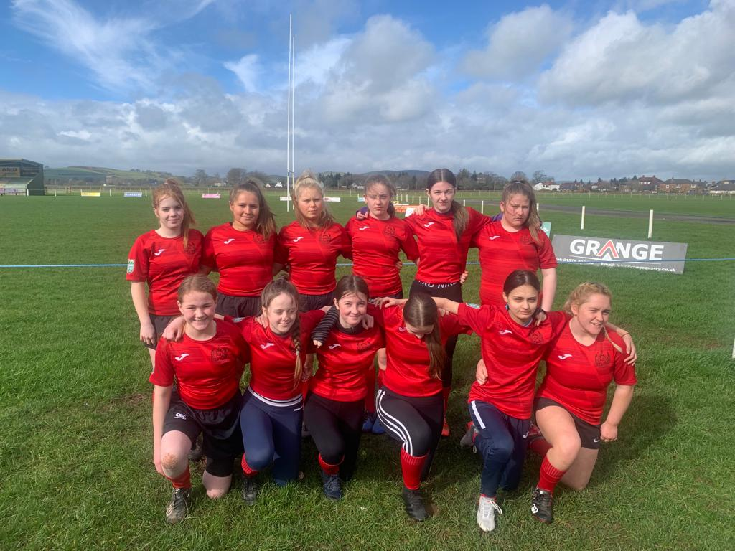
Rugby Under 14s/U16’s

Slide 51
Player of the Year

Slide 52
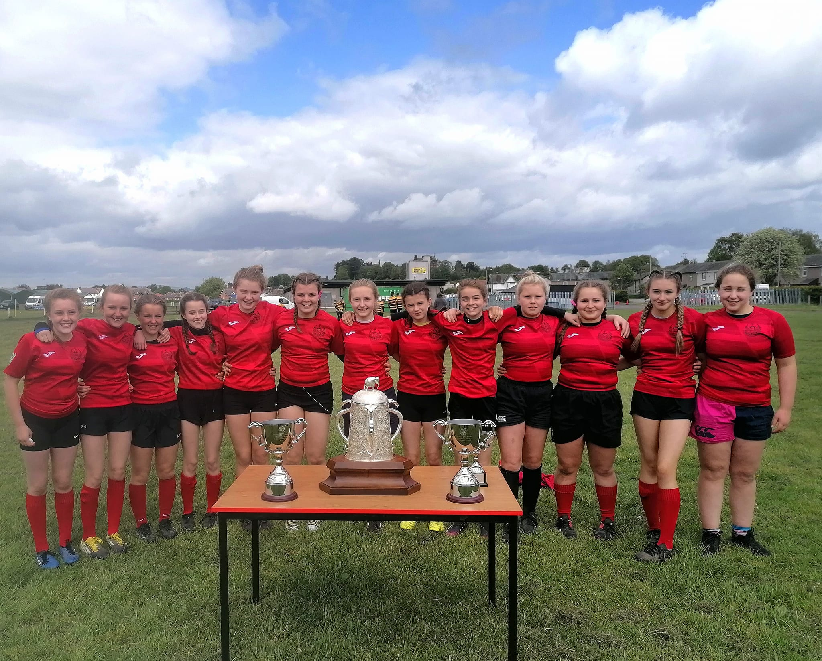
U14 GIRLS – Team of the year shortlisted

Slide 53
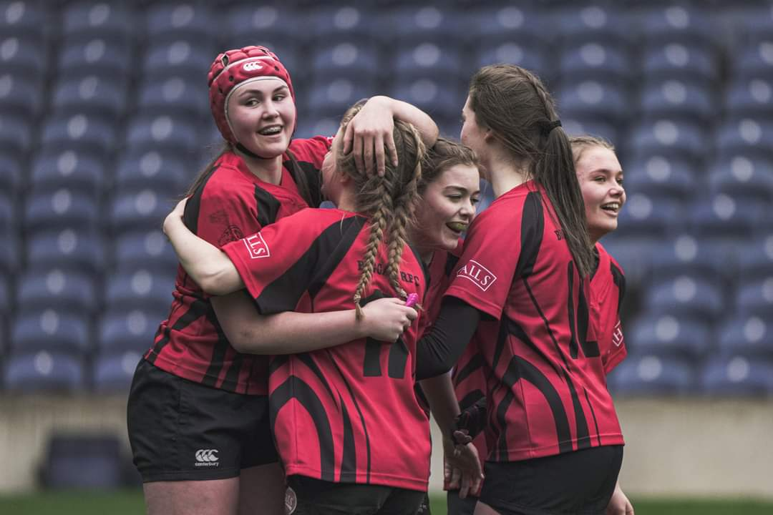
IMOGEN SPENCE
U16s Scotland Develop Squad
Captained Biggar to U16 Scottish Youth Cup Final
Imogen captained her team for the win and Player of the Match

Slide 54
Lockerbie Academy
Sports Club Awards
2022-2023

Slide 55
S4 Presentation

Slide 56
Lockerbie Academy
Sports Club Awards
2022-2023

Slide 57
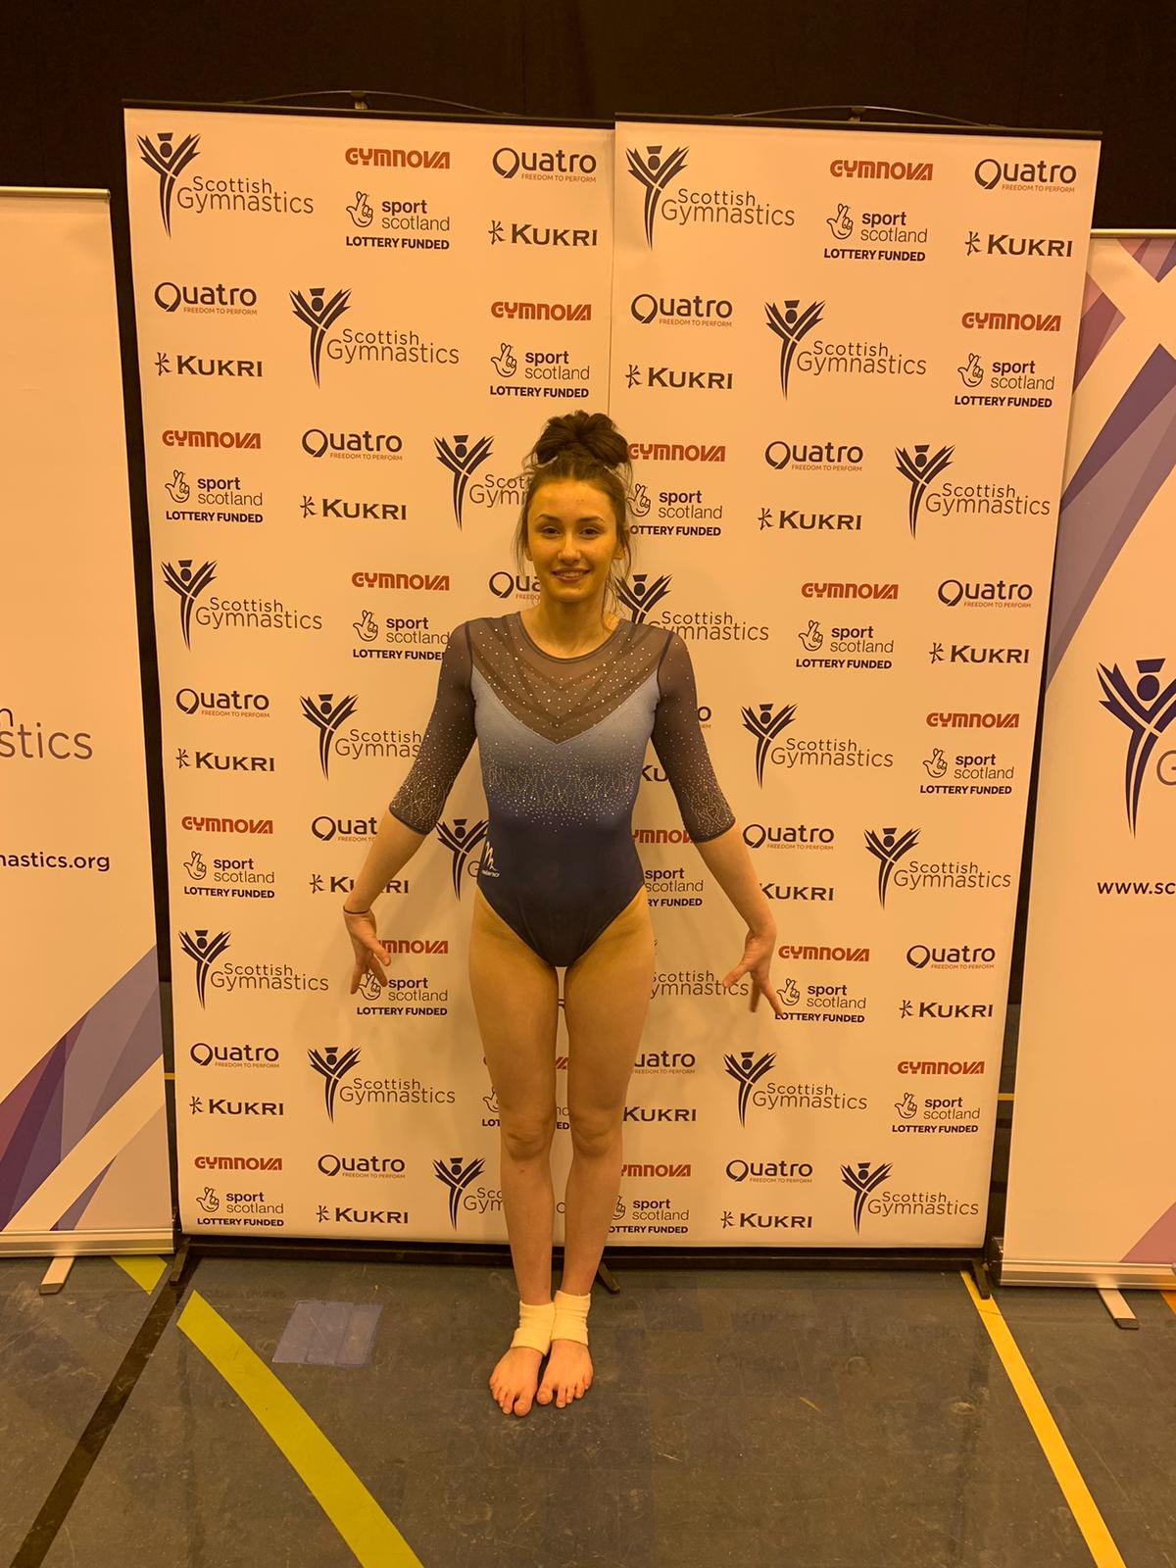
Sommer Dean
Highlights
4th in beam finals at the Senior Scottish Championships
Top 15 finish all round at the Scottish Championships
Coaching qualification Level 1 through Scottish Gymnastics

Slide 58
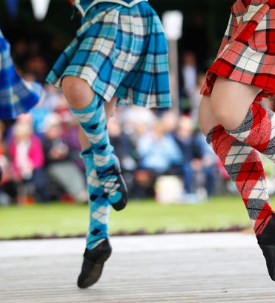
Dance
Classical
Ballroom
Latin
Highland Dance
Jazz
Ballet

Slide 59
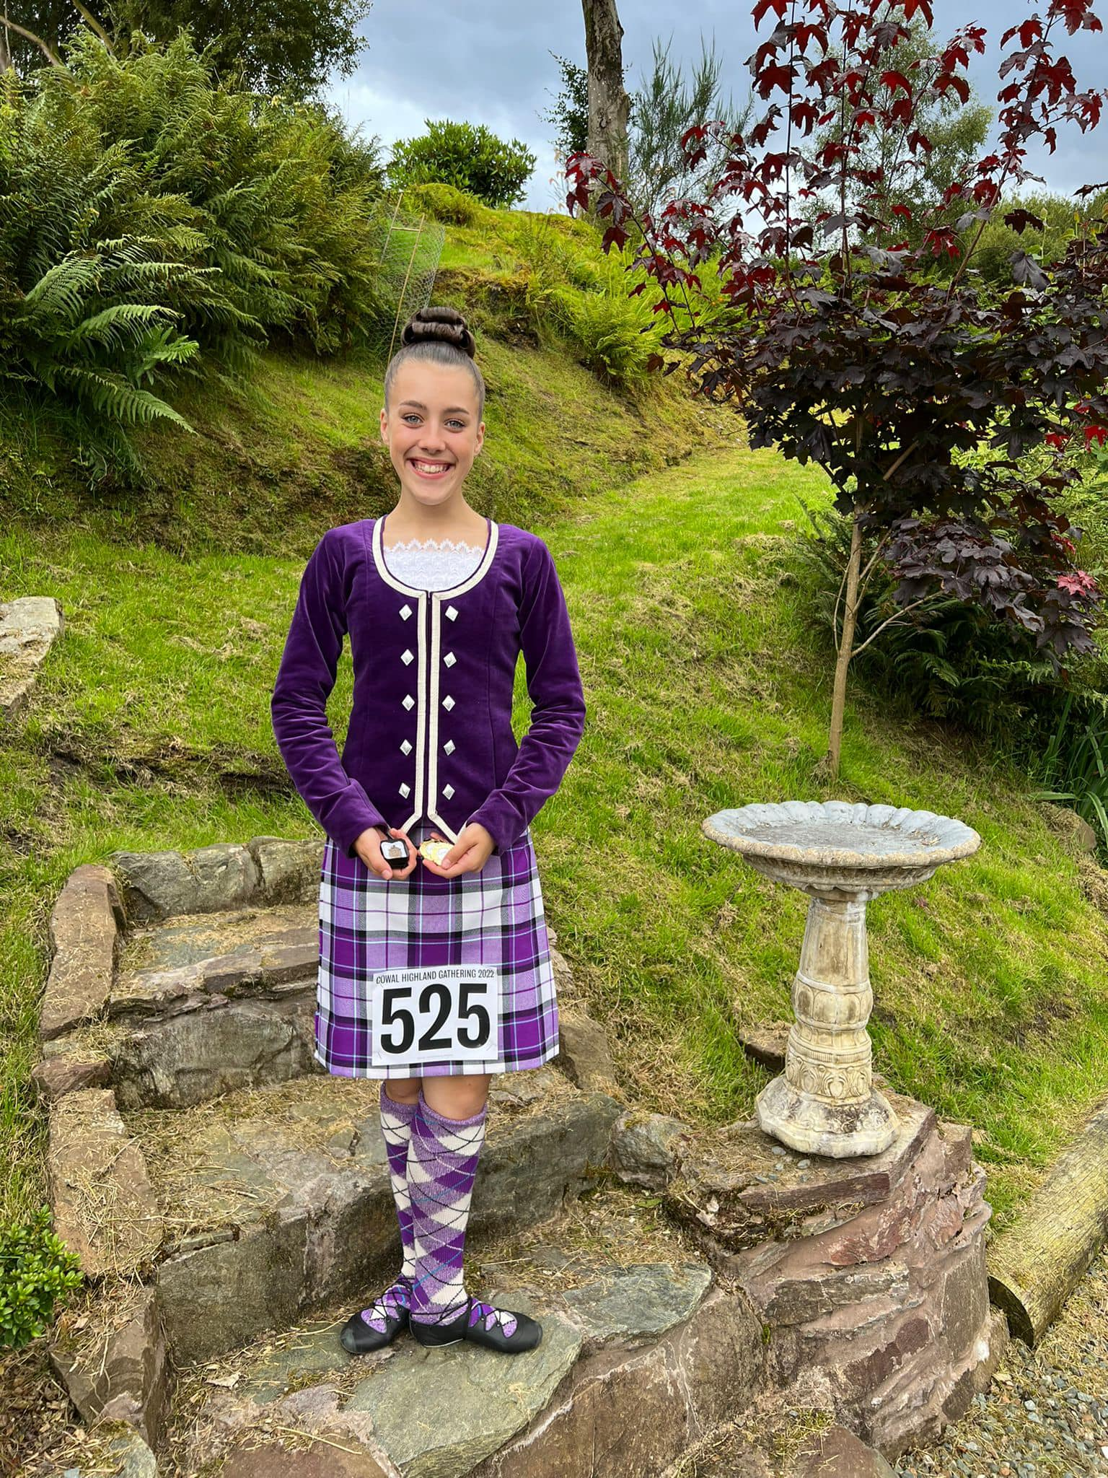
Freya Callander
Highlights
Selected to dance at Braemar Highland Gathering for the new King
Place in both Scottish Open and Scottish National Championships at Cowall
North American Championship placer
Distinction in G8 Theory Exam - Highland
Distinction in G4 RAD Ballet Exam

Slide 60
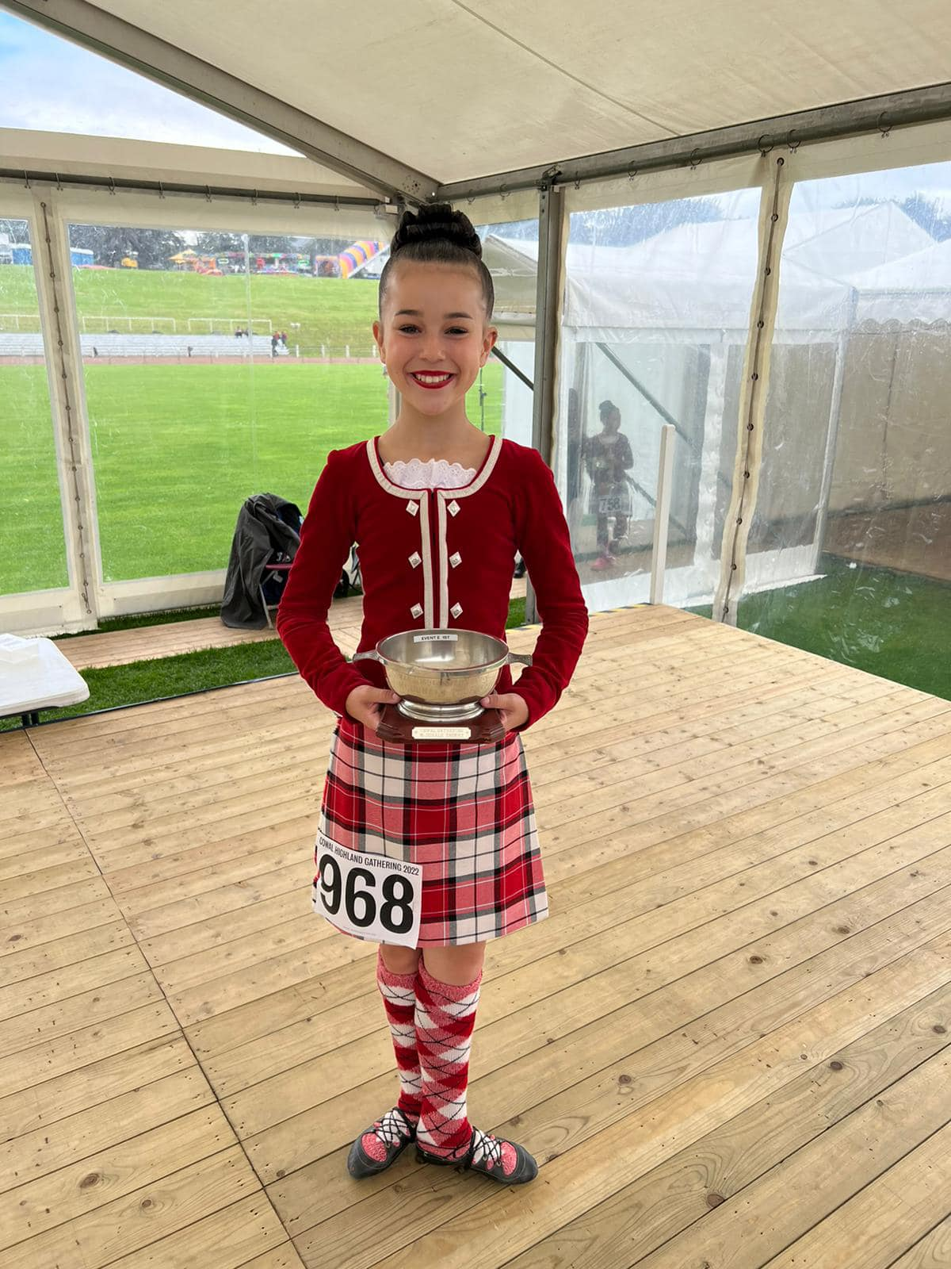
Lola Callander
Highlights
World Juvenile Qualifier – Top 20 in the world
Scottish champion at Scottish National Championships
North American Champion at the North American Open Champs
Overall runner up in the 13 years UK championships
Placed top 3 in every championship event in 2022

Slide 61
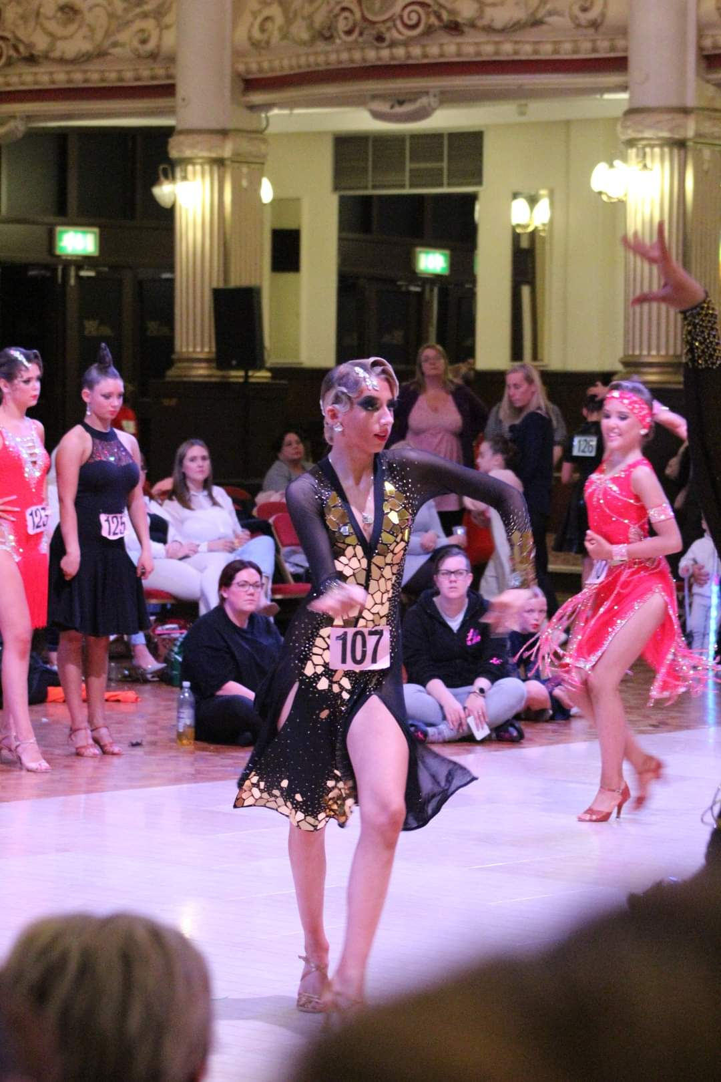
Zoe Patterson
Highlights
Competes in Classical, Ballroom and Latin Dance all over the UK
Representing Scotland in a team match at the Junior Dance Festival in April
British Championships – 6th, 8th, 9th and 11th place in Junior Open Solos for Windsor Glide, Tango, Samba Katrina and Engagement
Placed in competitions throughout the UK

Slide 62
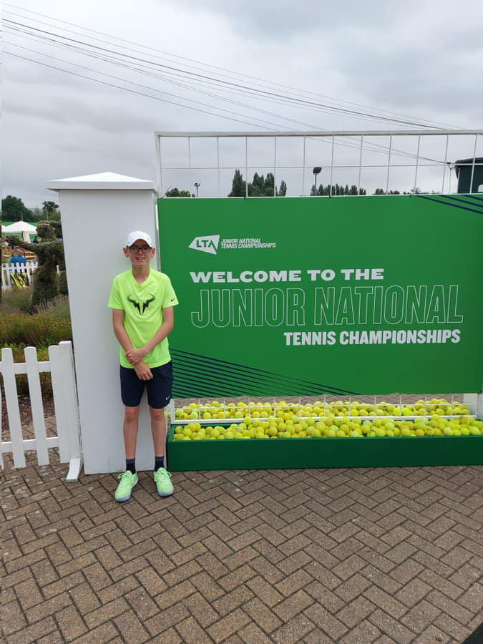
Tennis: Brodie Little
Highlights
Represented South of Scotland at U12 and U14 at LTA County Cup as #1 player, as well as stepping up to U18 team
Number 2 ranked in Scotland for U13
UK National Player Pathway List
Training with Tennis Scotland at Stirling University (National Programme)
Placed in National Grass Court Championshiops, UK National Championships, Indoor Championships.

Slide 63
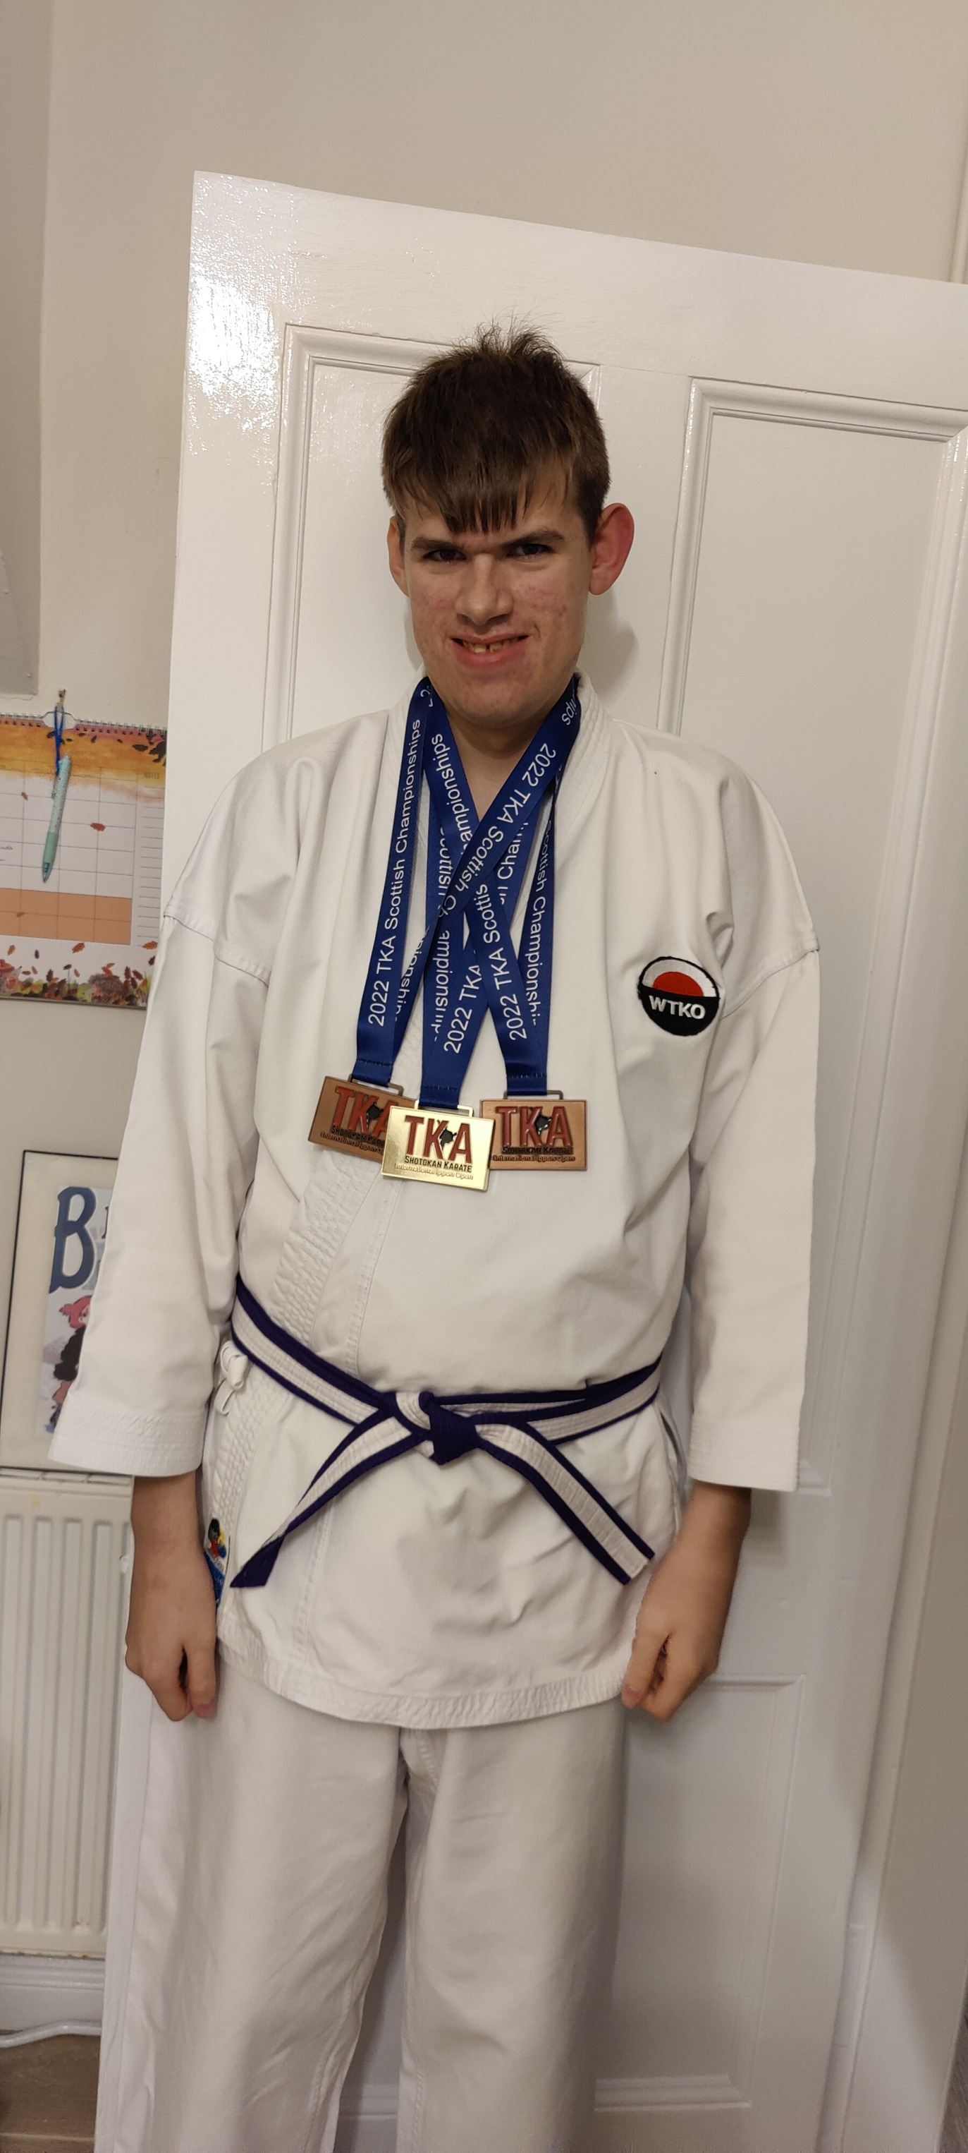
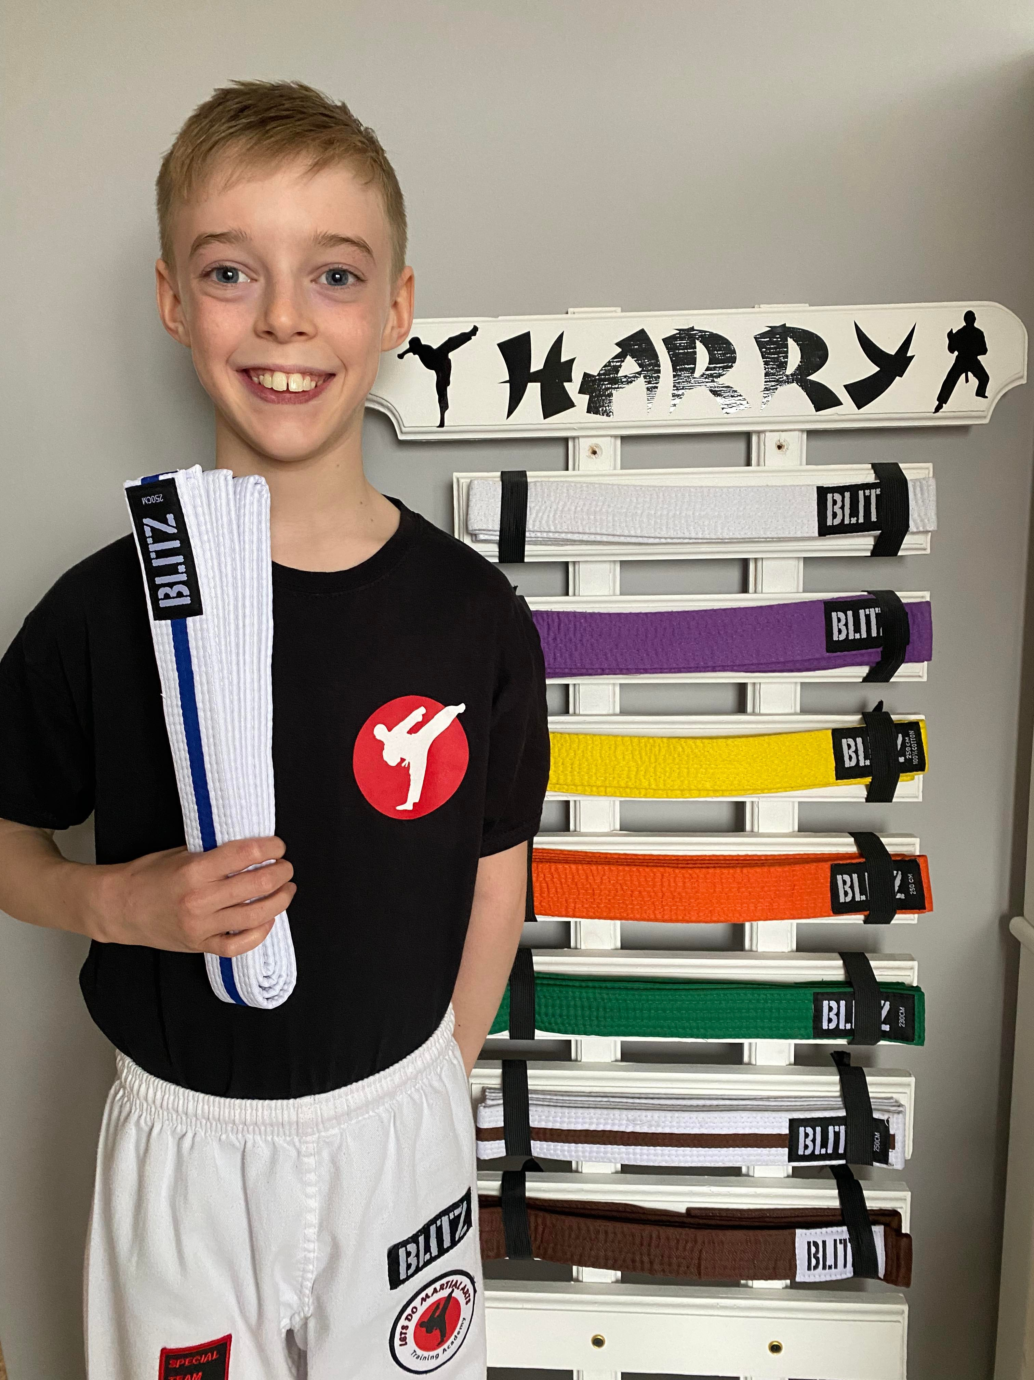
OTHER NOTABLE PERFORMANCES
Liam Grieve
Harry McDowall

Slide 64
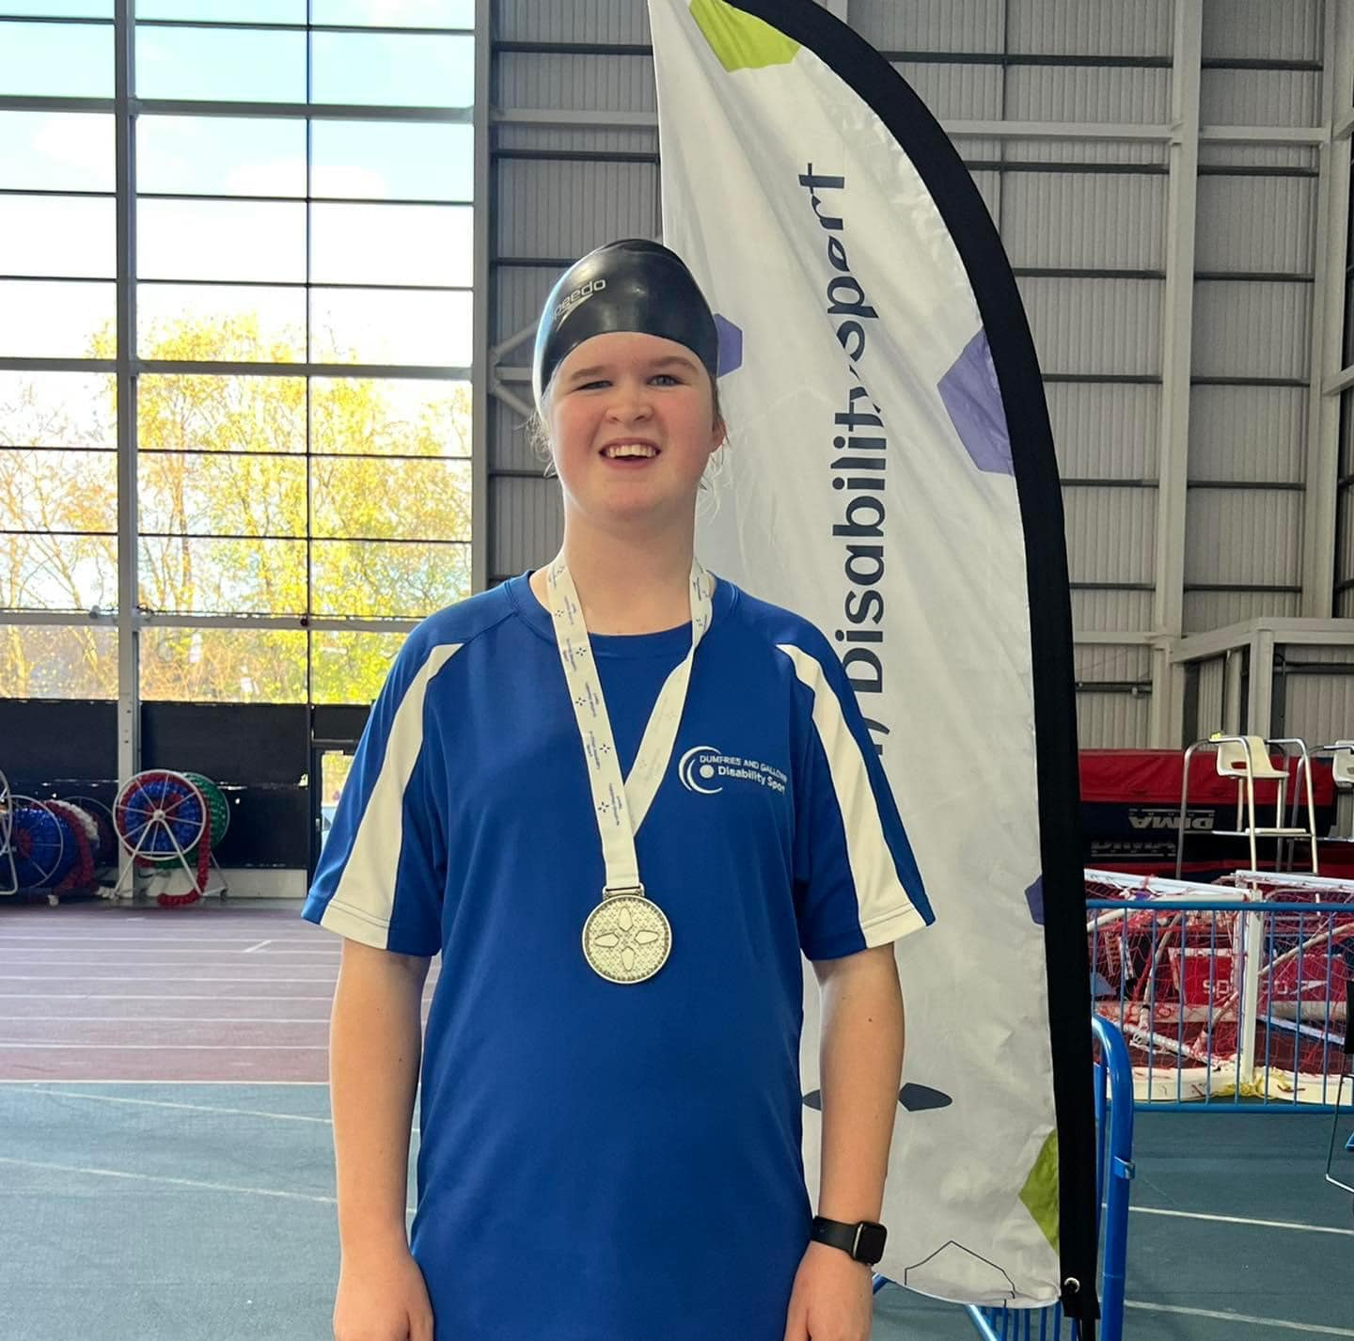
Eleanor Little
Highlights:
Athletics, Boccia and Swimming competitions
Boccia
  Represented D&G Schools at National Boccia Championships
Swimming
  2 Silvers at Regional Swimming
  2 Silvers and 1 Gold at National Swimming Championships
  Selected to represent D&G at West Scotland Champs – 2 Silver and 1 Gold

Slide 65
S5 & S6 Presentation

Slide 66
Lockerbie Academy
Sports Club Awards
2022-2023

Slide 67
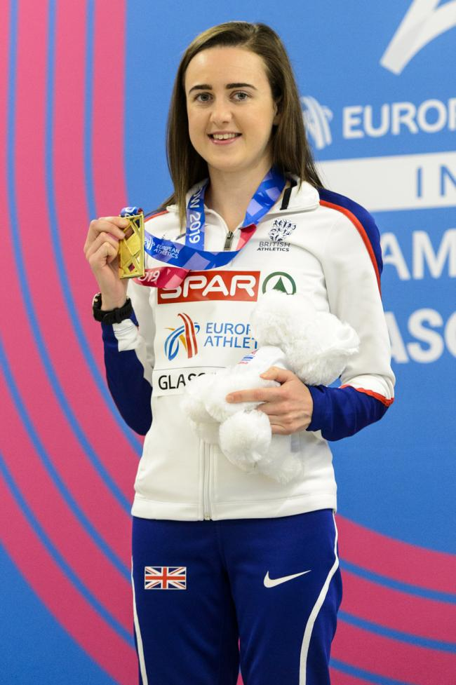
Who is this?
Notes:
Laura Muir: GB/Scottish 800m/1500m/3k/5k athlete, originally from Dundee Hawkhill Harriers athletics club.
Scottish, British, European champion and world medallist.

