Slide 1


Lockerbie Academy
Sports Club Awards
2022-2023

Slide 2

Performance Awards
National 5 & Higher

Slide 3
Lockerbie Academy
Sports Club Awards
2022-2023

Slide 4
Sports Leaders

Slide 5
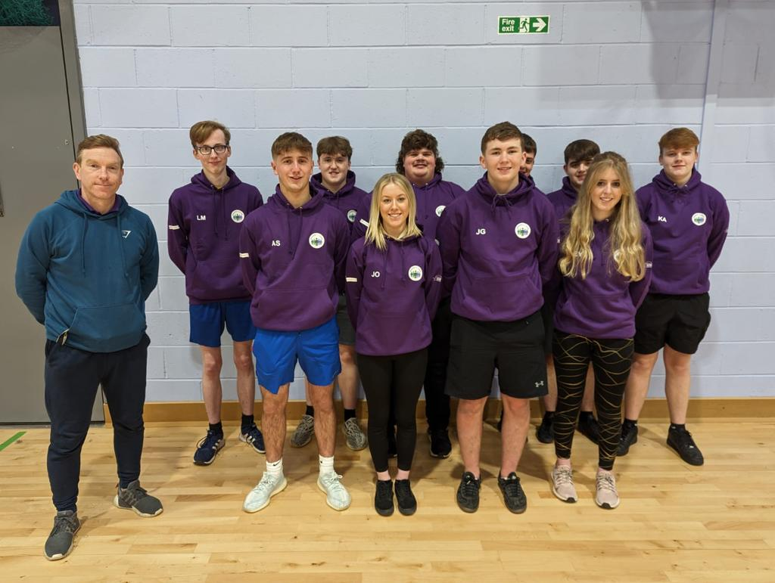
Level 5 Community Sport Leaders Course
Completed individual Learning Evidence Records
Worked with Active Schools and local coaches to develop leadership skills
Delivered over 100 voluntary hours delivered at school and community sport events
Led and supported school P7 Transition and Ceilidh events

Slide 6
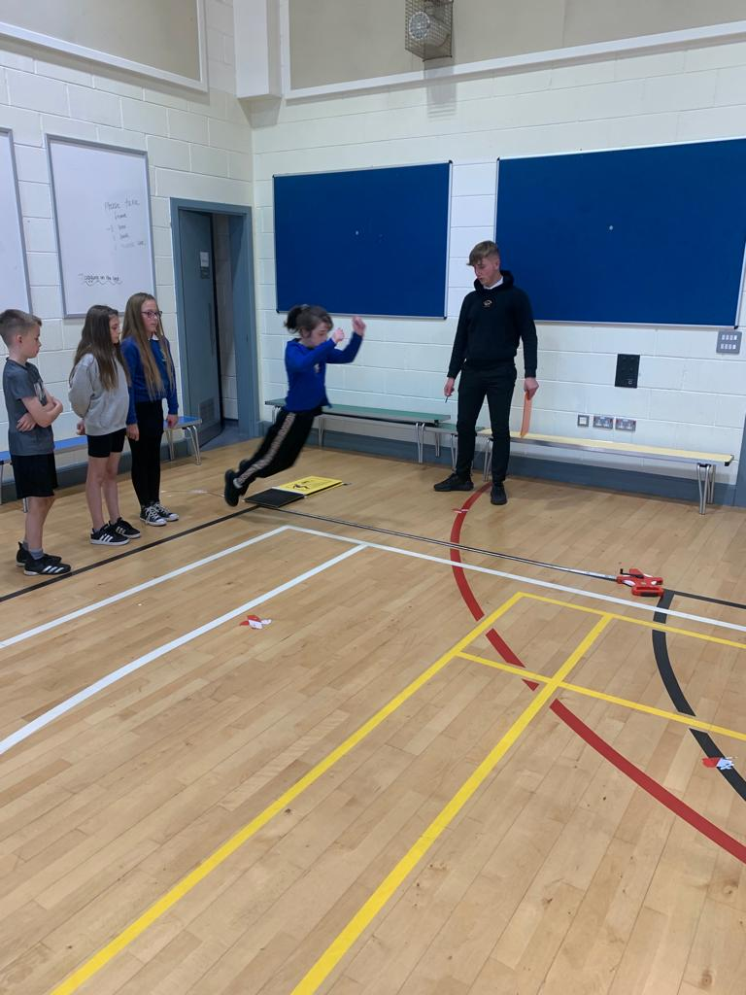
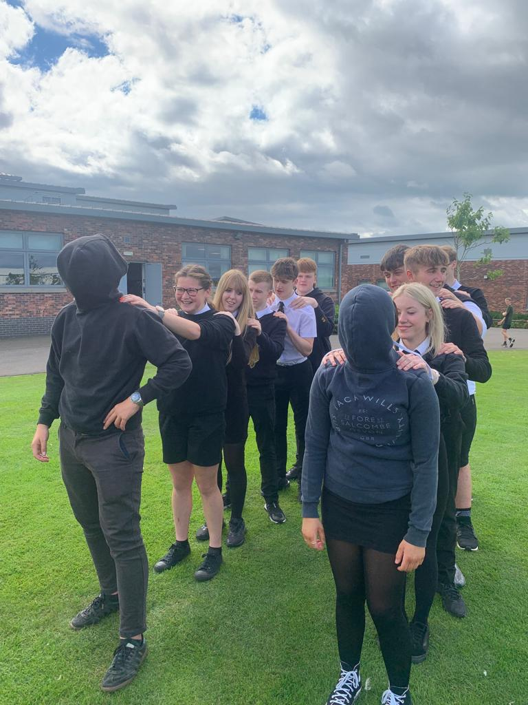
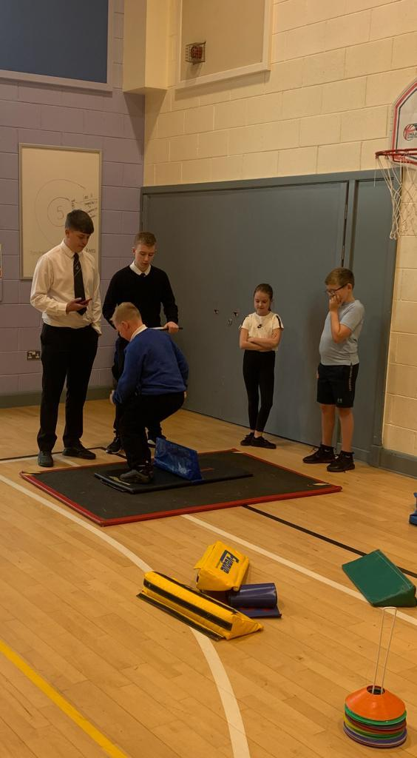
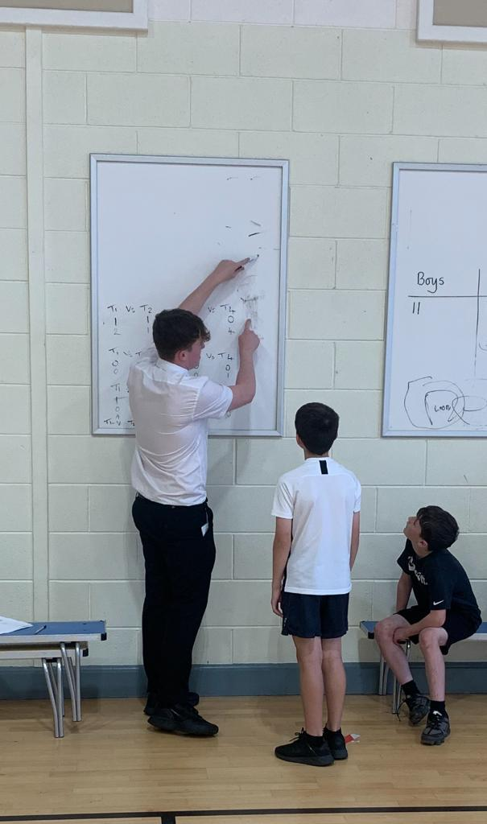
Level 5 Community Sport Leaders Course

Slide 7
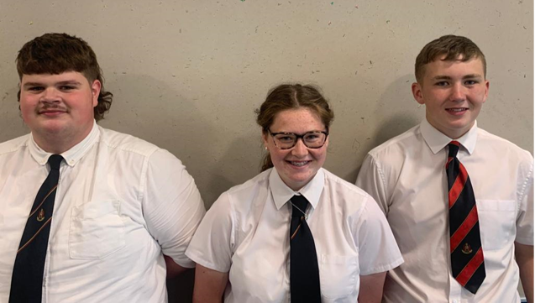
Young Sports Ambassadors

Slide 8
Lockerbie Academy
Sports Club Awards
2022-2023

Slide 9
Team of the Year

Slide 10
Shortlisted
U16s Football
U16s Girls Rugby
NSEA team for Hickstead
Pistol Shooting
S3 Girls 4x100m Relay team

Slide 11
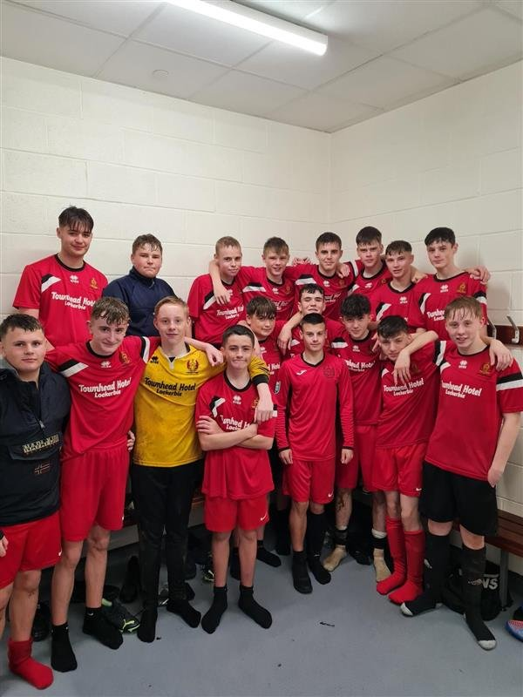
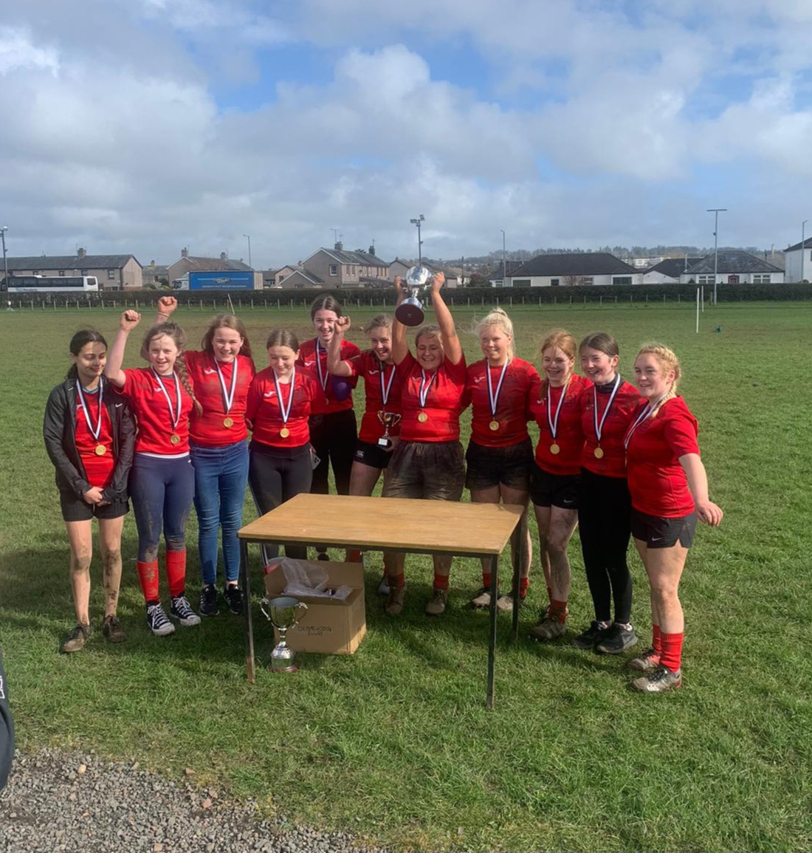
U14 Girls Rugby & U16 Boys Football

Slide 12
Lockerbie Academy
Sports Club Awards
2022-2023

Slide 13
Outstanding Achievement
Junior

Slide 14
Shortlisted
Lola Callander
Megan Hutchinson
Tara Kane
Brodie Lewis
Harry McDowall
Zoe Patterson
Isaac Scott

Slide 15
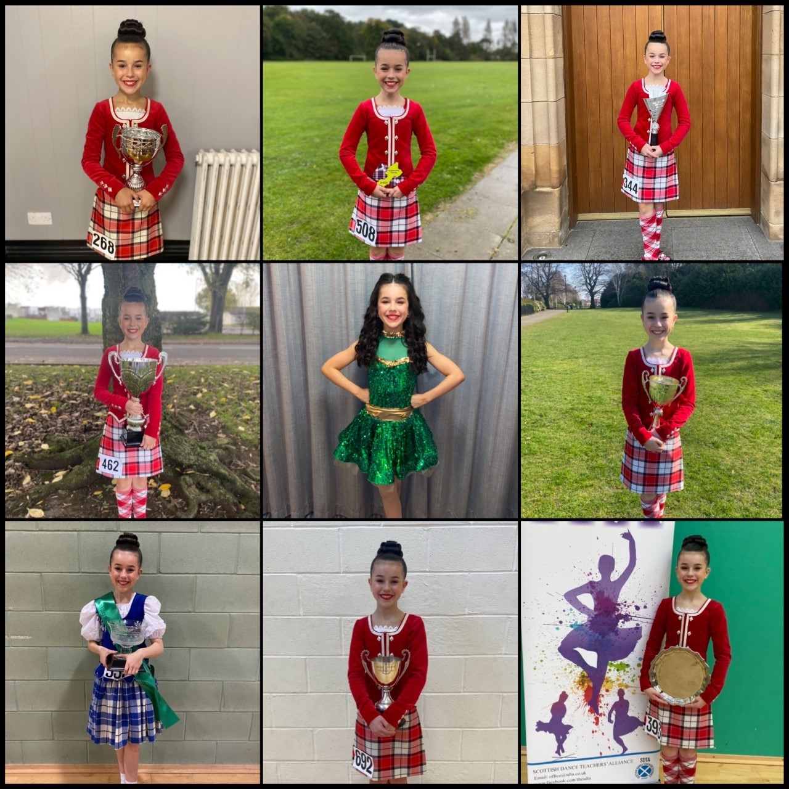
LOLA CALLANDER

Slide 16
Lockerbie Academy
Sports Club Awards
2022-2023

Slide 17
Outstanding Achievement
Senior

Slide 18
Shortlisted
Freya Callander
Sommer Dean
Kayla Dinnin
Kiera Graham
Eleanor Little
Owen Rae
Adam Scott
Imogen Spence

Slide 19
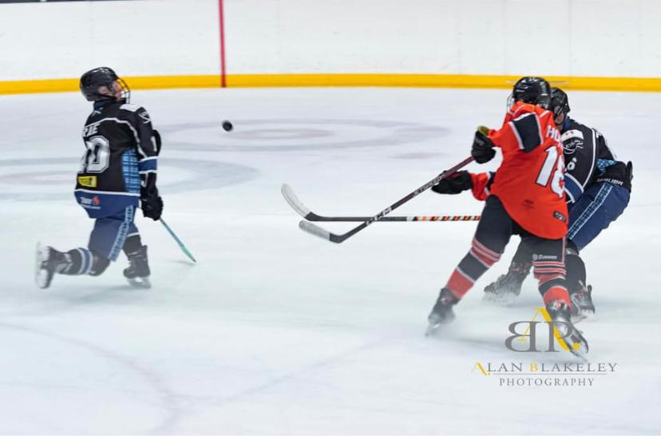
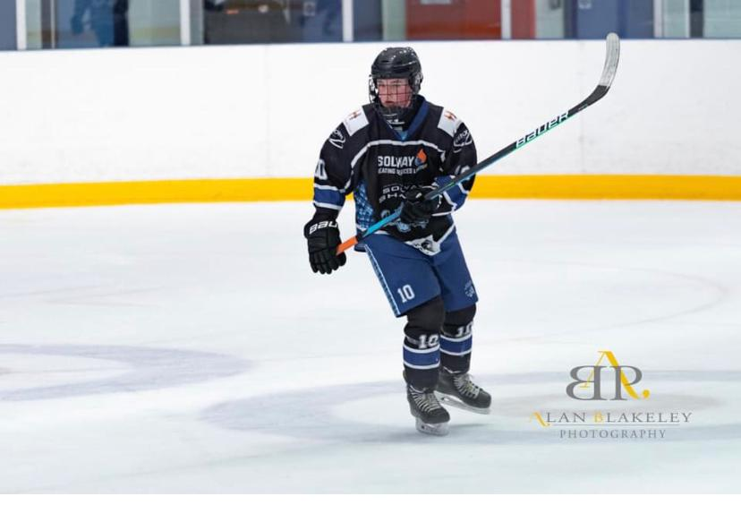
OWEN RAE

Slide 20
Lockerbie Academy
Sports Club Awards
2022-2023

Slide 21
Lockerbie Academy
Sports Club Awards
2022-2023
THANK YOU!

