Slide 1
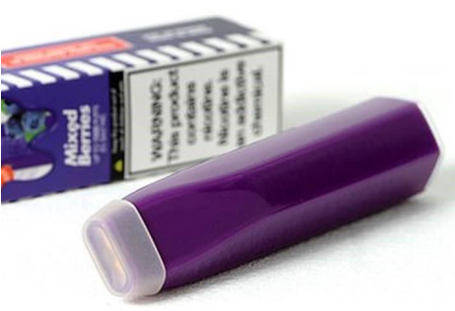
Vaping Products
There has been a recent rise in reports across the UK of potentially dangerous vaping products being found on sale.
These products are commonly referred to as ‘disposable vapes, ‘nicotine puffs’, ‘Elf Bars’ or ‘Geek Bars’.
The vapes look similar to a highlighter pen as shown below.
The price, design, and flavours of these vapes, combined with widespread publicity on social media, make them particularly attractive to young people.

Slide 2
Concerns
Some products have been found to contain an excessive amount of nicotine (see next slide) which is harmful in continual consumption.
Media reports have highlighted the adverse reactions young people have experienced when using these products.
In addition, many products being sold do not meet the safety standards required for sale in the UK
The current UK law states: Selling vaping products to anyone under 18 is prohibited and so is buying vaping products for anyone under 18.

Slide 3
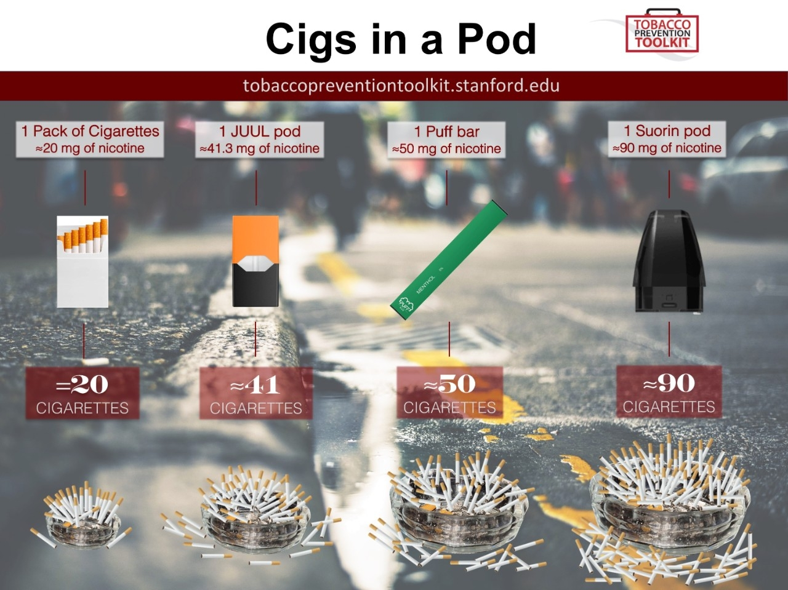

Slide 4
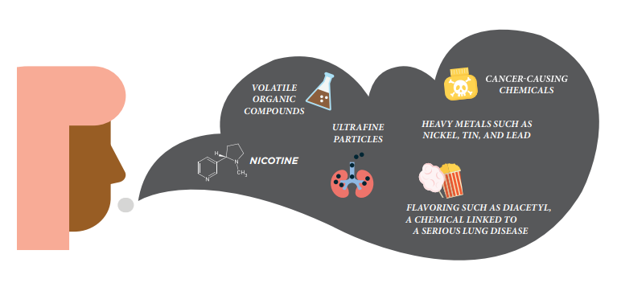
Health Impact
Exposure to all kinds of chemicals that we don’t yet understand and that are probably not safe
E-cigarettes heat nicotine (extracted from tobacco), flavourings and other chemicals to create an aerosol that you inhale: lung injuries and deaths associated with vaping
Nicotine is a toxic substance. It raises your blood pressure / adrenaline, increases your heart rate and the likelihood of heart attack – nicotine can be very strong in vapes especially unregulated ones.
Nicotine is highly addictive - many e-cigarette users get higher concentration of nicotine, or by increasing the e-cigarette’s voltage

Slide 5
Role of Trading Standards
Investigate complaints of traders selling to people not of legal age and traders not operating an age verification policy where they appear to be under 25 years old.
Problems identified include:
Tanks larger than 2ml. Nicotine strength greater than 2%.USA can sell products with up to 5% nicotine, UK law restricts this in Regulation 36 of the Tobacco and Related Product Regs 2016.
No information leaflets (Regulation 37).
Health warnings missing, wrong wording, or not prominent enough. Not notified to or published by the MHRA.
Sale to under 18s as social media appears to be encouraging their use.
Counterfeits or grey import.

Slide 6
Why is it popular with young people?
Many teens believe vaping is less harmful than smoking
E-cigarettes have a lower per-use cost than traditional cigarettes
Many young people and adults find the lack of smoke appealing. With no smell, e-cigarettes reduce some of the stigma of smoking
Vaping can be done undetected including smoke alarms etc
They can be purchased easily on line and delivered to homes undetected
Vaping has been glamorised by social media

Slide 7
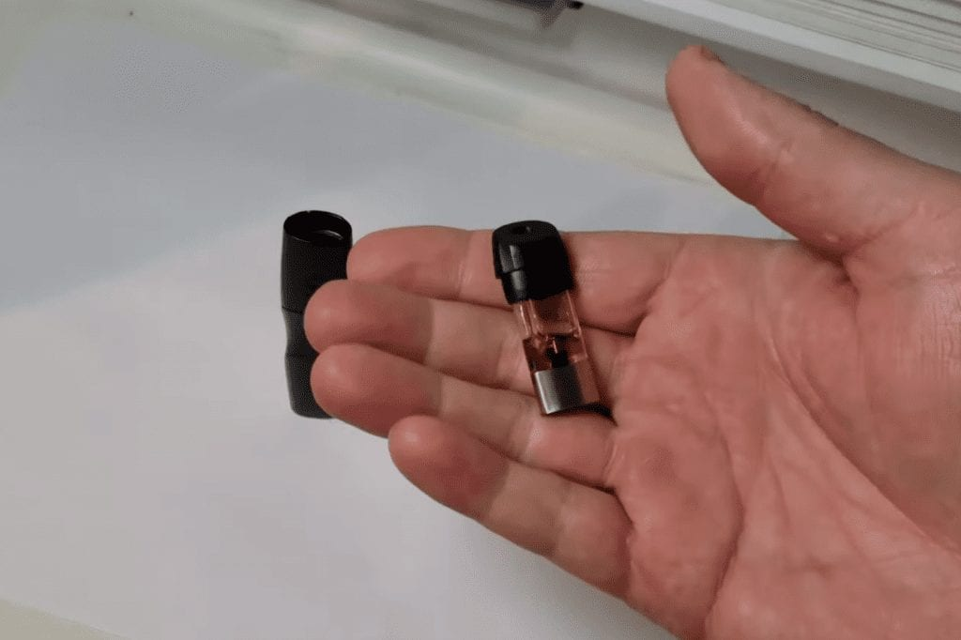
Hidden devices
Teens are currently using a wide range of devices that allow them to vape undetected, right under the noses of adults.
Often, these vaping products are disguised to look like common household objects such as watches, writing pens, and even clothes.
Some are TINY!
Here are some hidden examples…

Slide 8
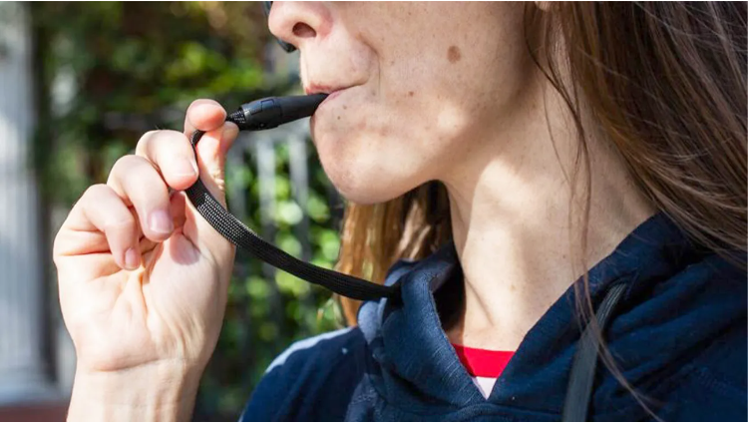
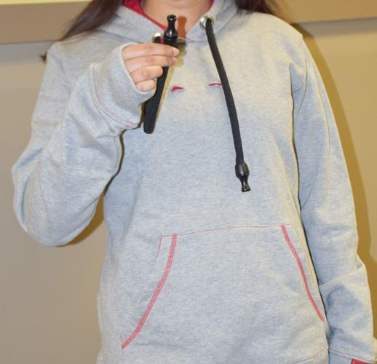
Hoodies
Hooded sweatshirts are a staple in most teen wardrobes so it probably won’t arouse suspicion when your teen shows up at breakfast one morning wearing a new one, but it should.

Slide 9
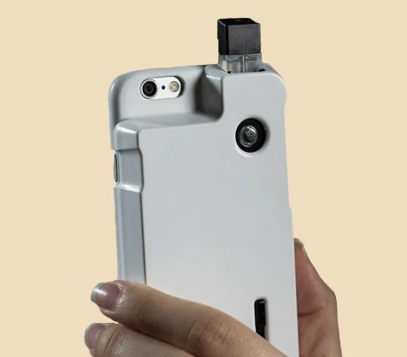

Phone cases
With smartphones being found in the hands of most teens these days, you may not even think twice about them getting a new phone case, but be aware that their latest accessory could also disguise a vaping habit.
Vaping phone cases fit over a smartphone just like a normal case, but with a big difference: You can attach an atomizer to it and vape e-liquids.

Slide 10
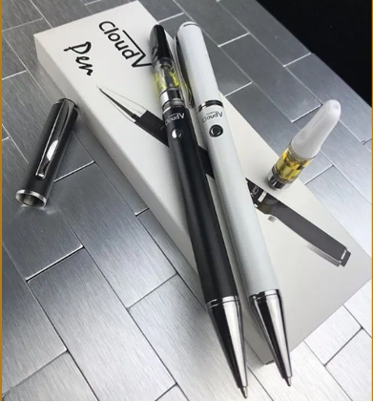
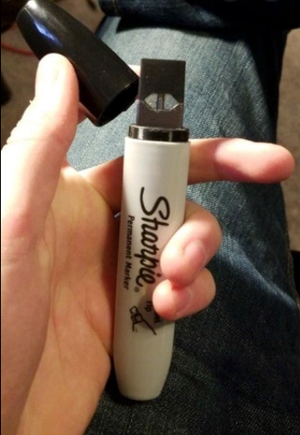
Pens
There are vape pens that are purposely designed to look like pens in order to hide their true function.
There are even vape pens on the market that have been cleverly designed to be an actual pen. All the user has to do is unscrew the top of the pen, insert a cartridge and then vape through the top of the pen.

Slide 11
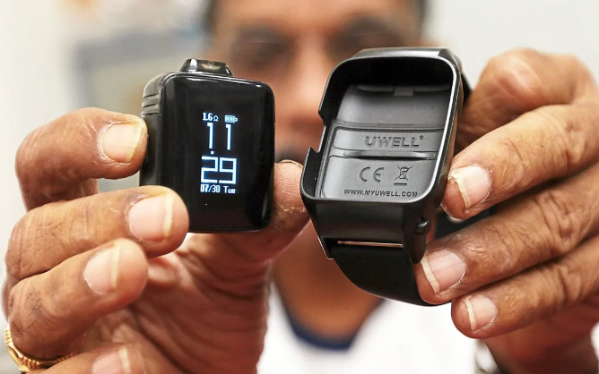
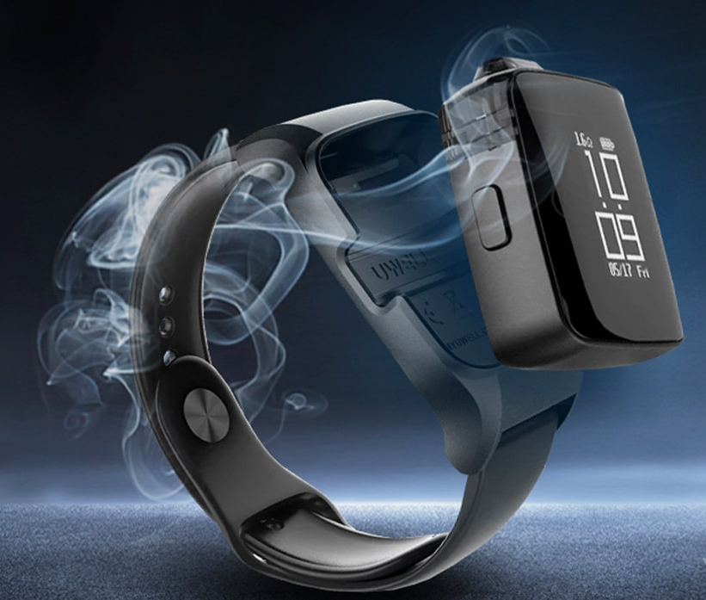
Smart Watches
While they may look like a smart watch at first glance, and even tell you the time and date, a press of a button allows the user to remove a pod from the watchband which can be used as a vape.

Slide 12
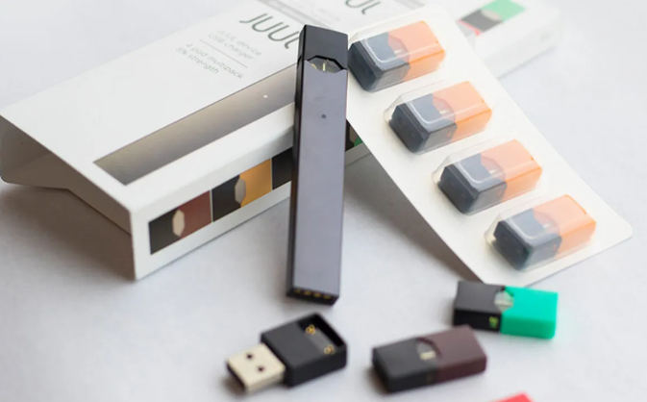
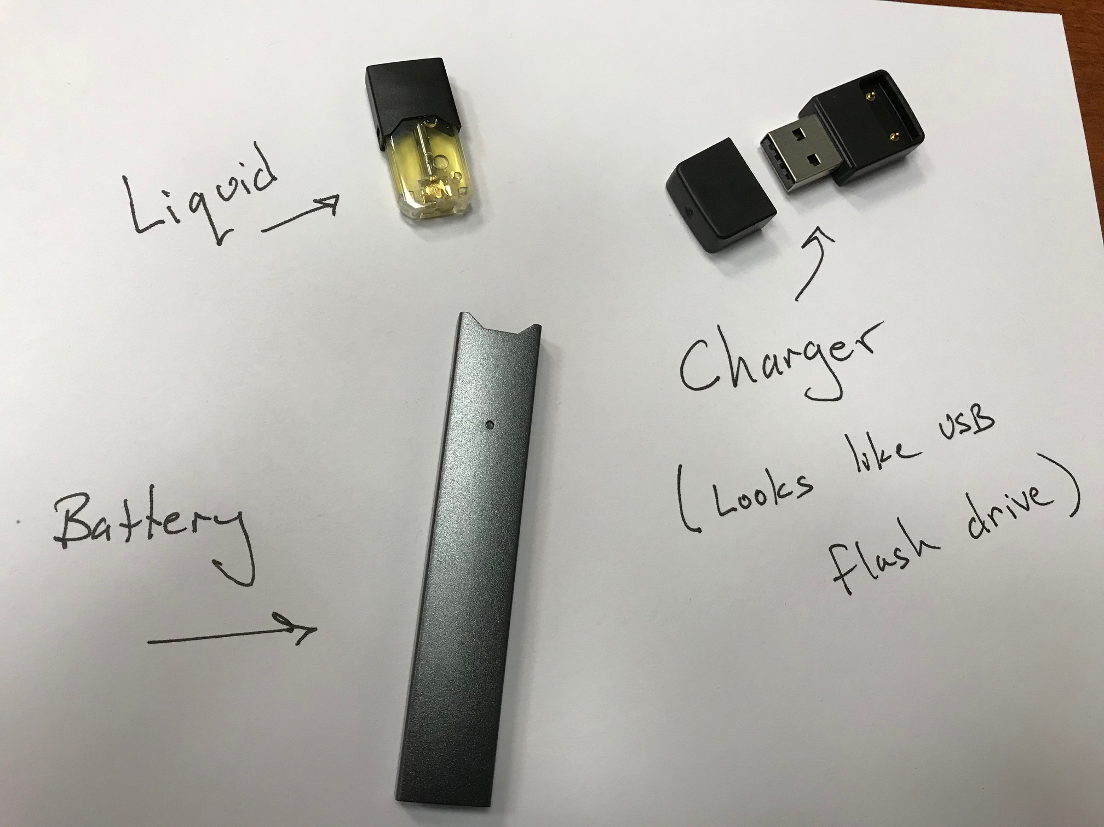
USB Drives
Some devices closely resemble a USB drive, these have become a very popular option for teens to hide their vaping.
All they need to do is toss it in their backpack, and unsuspecting parents are none the wiser that the device isn’t a USB drive with data needed for homework.

Slide 13
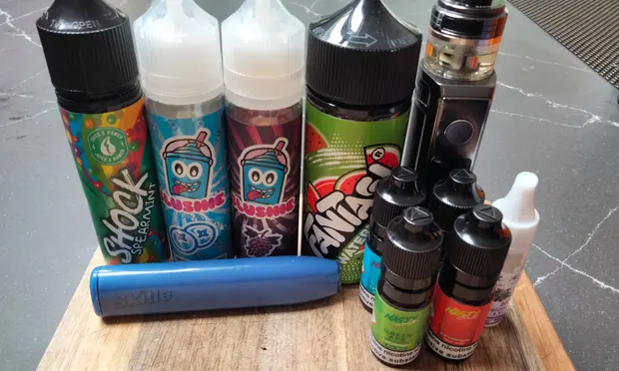
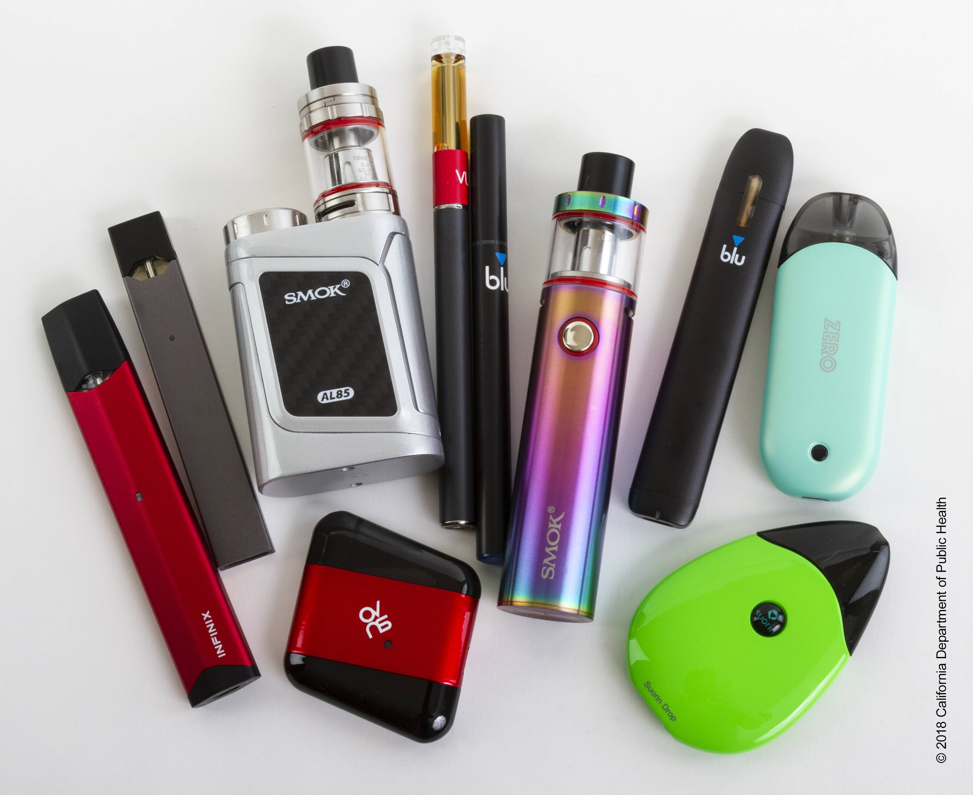
Vapes and vaping liquids – all shapes and sizes

Slide 14

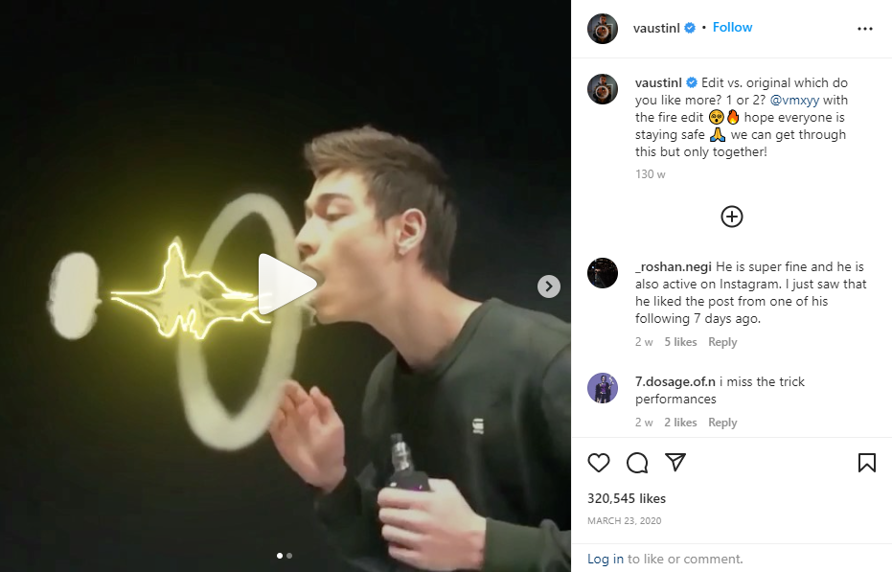
The power of Social Media…

Slide 15
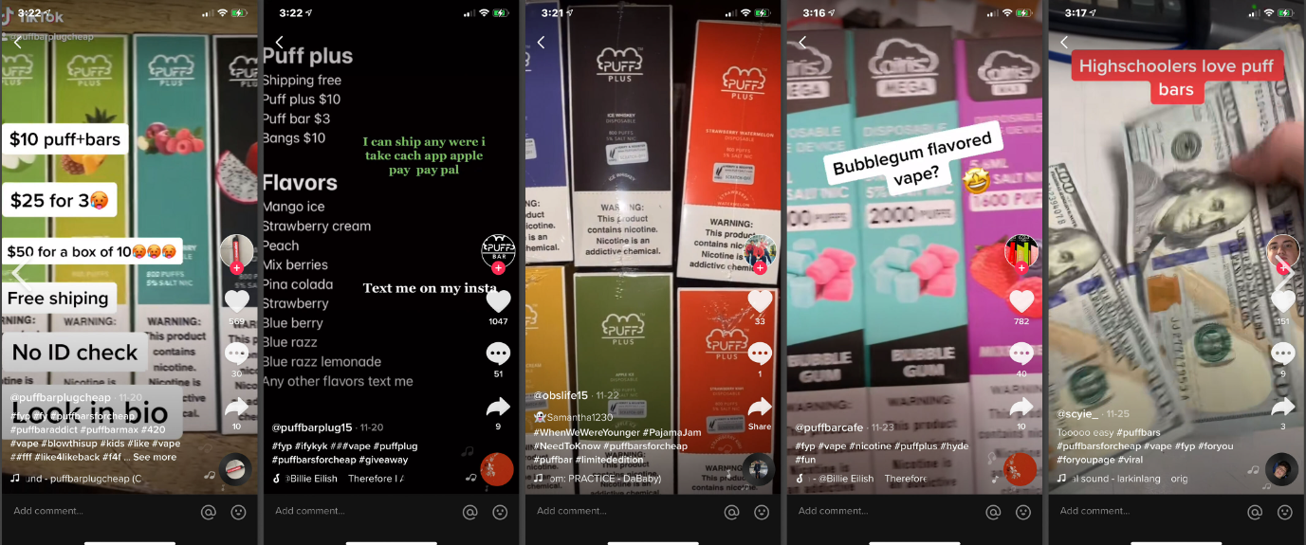
Vape deliveries via TikTok…
Sellers are offering flavoured disposable vapes, parent-proof 'discreet' packaging, no ID checks

Slide 16
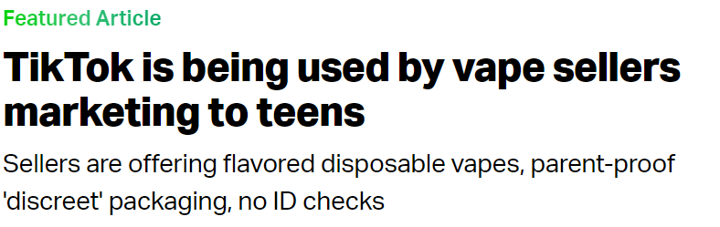
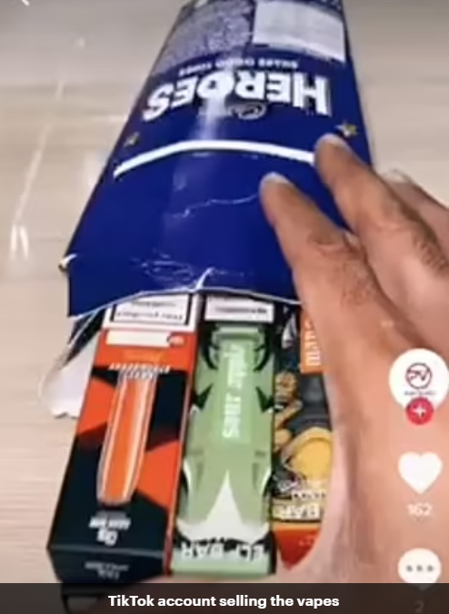
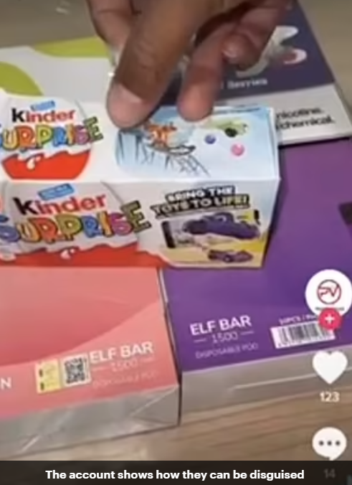
Keep an eye on deliveries coming to your house…

Slide 17
Who to report to
Dumfries & Galloway Trading Standards Service would like to further understand the presence of these products in the region.
We are particularly keen to understand where these products are coming from and who may be selling them. Any information on particular products, photos etc. would be appreciated.
We would be obliged if any information can be sent to tradingstandards@dumgal.gov.uk
Thank you to Moffat Academy for sharing their resource.

