Slide 1
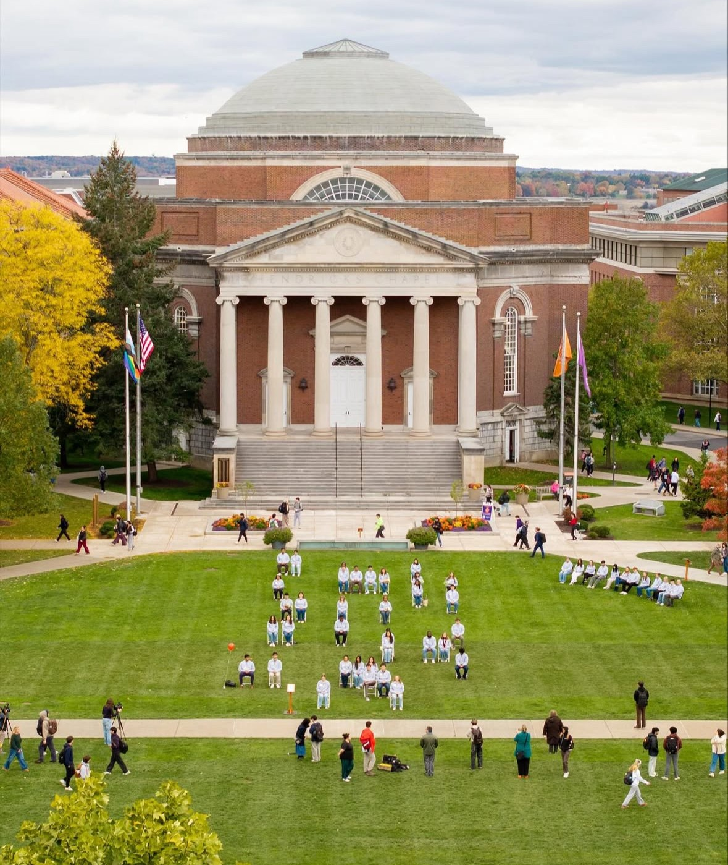
Lockerbie Fellows 2026-2027
Stage 1: due Sunday 12th April 2026 (5pm)
Write a letter to Ms Currie, in it, please address the following:
Why you are interested in the Lockerbie Fellows programme
Why you are interested in Remembrance Week at Syracuse University
What you will contribute to the Lockerbie Fellows programme
You must include the following information on your academic ability- Subject / Level / Estimate Grade for S5, and Subjects / Levels for S6 timetable. Please note, to be eligible for this Fellowship programme, you must be aiming for a minimum of 5 Level 6 (Higher) courses by the end of S6
Current hopes / aspirations beyond school

Slide 2
Lockerbie Fellows 2026-2027
Stage 1: due Sunday 12th April 2026 (5pm)
Write a response to the following and hand in with your letter – no more than one typed side of A4. You may write a news article, essay, poem, song – anything that uses your unique skills to react to this stimulus:
“The Kindness of Strangers”
It is now almost 38 years since the Lockerbie Bombing. At that time, Lockerbie was a focus as everyone tried to make sense of what happened. We want to see you engage with the history of the events show your understanding and demonstrate sensitivity in how you respond.
Announcement of Seniors progressing to Stage 2 will be announced on Wednesday 27th May

Slide 3
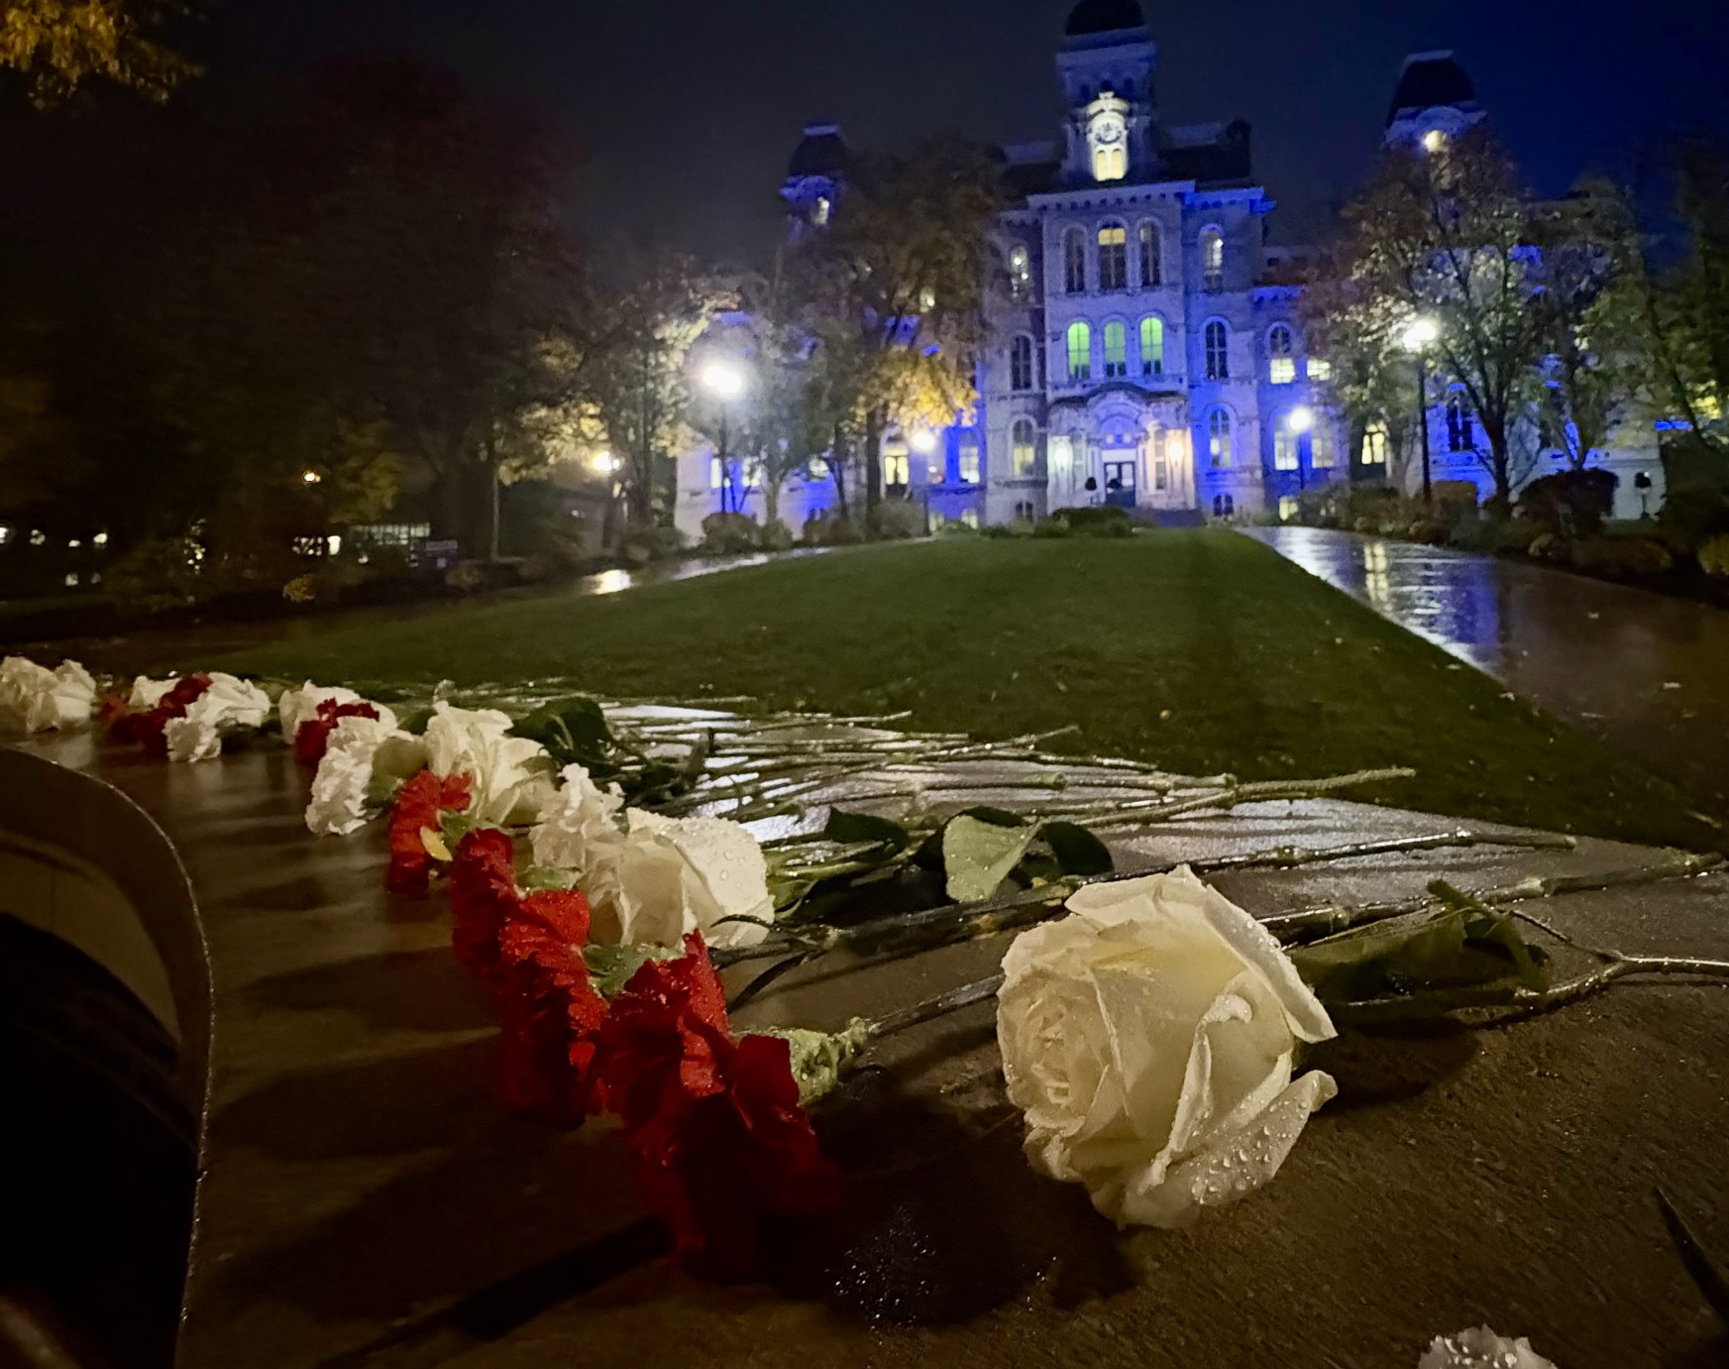
Lockerbie Fellows 2026-2027
Stage 2: Interview
Successful candidates will be invited to interview on Wednesday 3rd June
Prepare a presentation lasting no longer than 5 minutes
Your title is “Remembrance in Syracuse 2026”
Prepare by researching Remembrance Week
As a Lockerbie Fellow, how you will contribute
You can base this presentation on what your understanding is of Remembrance Week, research 1 of the Syracuse Students who lost their life, or a member of the Lockerbie community, present on the “Laundry Ladies” or any other aspect you have spent time researching
Show your understanding of what Remembrance Week is about, and what you plan to do throughout the year to ensure the Lockerbie Community has an opportunity to be involved

Slide 4
Lockerbie Fellows 2026-2027
Stage 2: Answer this follow up question
“Why should you be one of the 10 young people we select as a Lockerbie Fellow?”

Slide 5
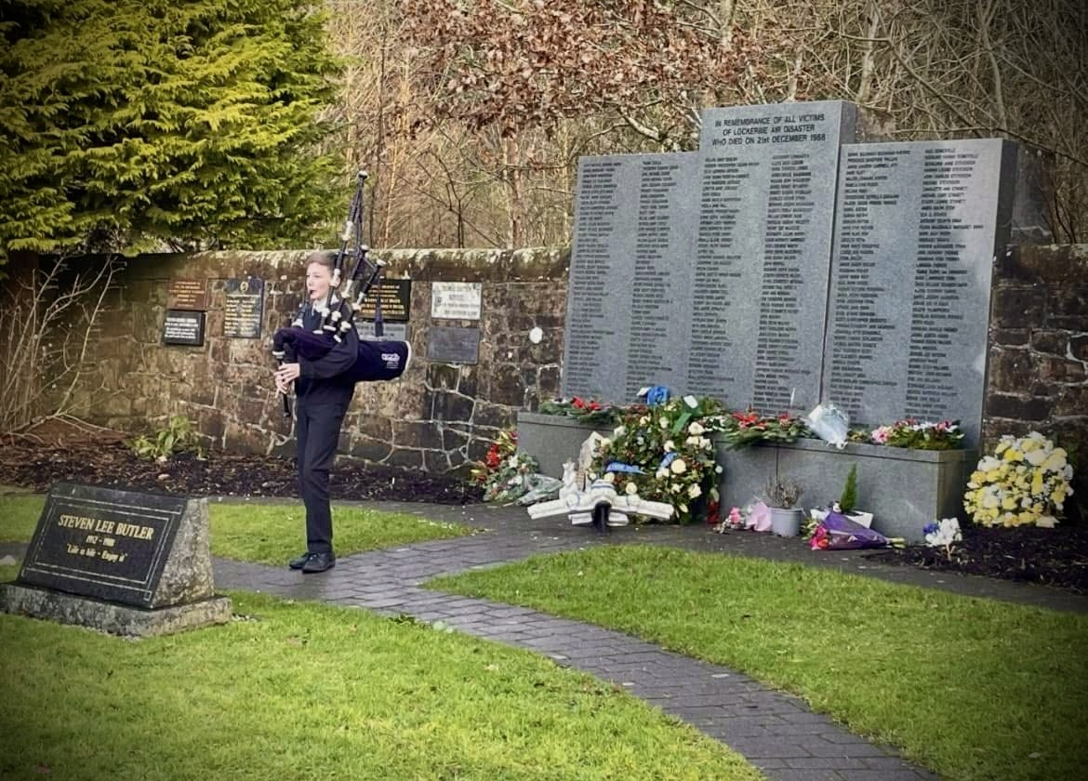
Lockerbie Fellows 2026-2027
Stage 3: Lockerbie Fellows will be announced on Friday 5th June 2026
Preparation
Lockerbie Fellows will meet once a week from August 2026
In June, you will prepare an “All About Me”, introducing yourself to Syracuse University Staff and Remembrance Scholars

