Slide 1











WIDER ACHIEVEMENT
OPPORTUNITIES

Slide 2




These slides show what is on offer at Lockerbie Academy. Look out for these
They show you which skills you can develop when attending. These skills are called "Meta Skills" and are valued by employers in Scotland.

Slide 3









RETRO GAME CLUB
Communicating
Who: S1-3
When: Fridays, 1.10-1.30pm
Where: Rm H110
Organised by Miss McKie

Slide 4







PRIDE NOT PREDJUDICE
Communicating
Who: S1-6
When: Thursdays, 1.15-1.40pm
Where: H113
The club is a safe space where all pupils and staff can meet to discuss topics and receive support from one another. You don't have to be LGBTQIA+ to come along, everyone is welcome! As a school we recently achieve the LGBT Youth Scotland Silver Charter Award.
Organised by: Miss Thompson and Miss Marzinotto

Slide 5





ABRSM GRADE 5
MUSIC THEORY
Communicating
Who: S3-6
When: Tuesday lunchtimes
Where: D022
For: Any pupil who is about to sit their ABRSM grade 6 practical exams and requires ABRSM grade 5 theory qualification can do this.
Organised by: Mrs Cowie

Slide 6







BIOLOGY STUDY
Who: S3-6
When: Wednesday, 3.20-4.20pm
Where: Rm 217
What: Study for pupils taking Biology as a subject
Organised by Ms McGillivray

Slide 7







NETBALL
Communicating
Who: S1-6
When: Tuesdays, 1.15pm
Where: Games Hall/Dance Studio
No PE Kit required, just wear sensible trainers!
Organised by: Mrs Meola

Slide 8





DUNGEONS AND DRAGONS CLUB
Who: S1-6
When: Mondays and Thursdays, 3.25-5.00pm
Where: H110
Organised by: Connor Christie (or see Miss McKie)

Slide 9






DISNEY CLUB
Who: S1-6
When: Tuesday lunchtimes
Where: G012
Organised by: Miss Costello

Slide 10





UNDER 16S FOOTBALL
Communicating
Who: S3-4
When: Mondays, 3.20-4.20pm
Where: Playing Fields
Organised by Mr Kempsell

Slide 11




AIR PISTOL SHOOTING
Integrity
Who: S1-6
When: Fridays, 4.30-7.30pm
Where: Off site. 3 miles outside Lockerbie. Details disclosed when confirmed attendance with Mrs Boardman
Organised by: Mrs Boardman

Slide 12



MUSIC CLUB
Who: S1-6
When: Tuesdays and Fridays, lunchtime
Where: D015
Organised by: Mr McKay

Slide 13

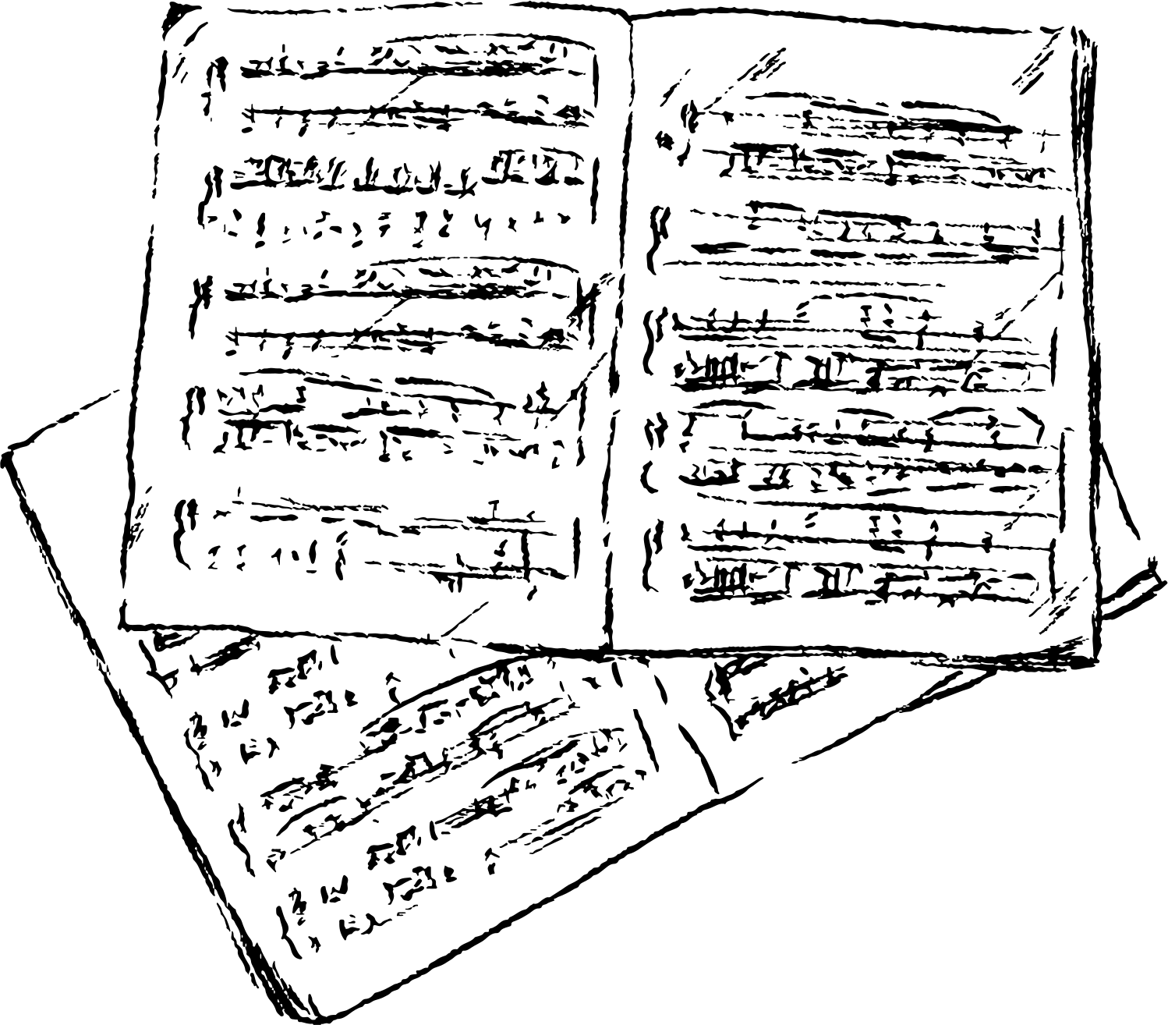
MUSIC
STUDY SUPPORT
Who: S4-6 Music/Music Tech pupils
When: Wednesday Lunchtimes (13:05-13:45) but drop in availbale any day if you speak to Mr McKay
Where: D015
Organised by Mr McKay

Slide 14
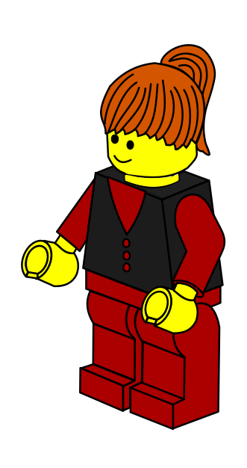



GAMES CLUB
Who: S1-6
When: Thursday Lunchtimes
Where: D015
What: A quiet collaborative space for learners to play board or card games, build jigsaws, construct lego or other models and relax.
Communicating
Organised by: Mr McKay

Slide 15



MINDFULNESS
SPACE
Who: S1-6
When: Mondays, Lunchtime
Where: G015
What: A safe space, with music and calming activities. All pupils welcome.
Organised by: Mr Martin

Slide 16

ART CLUB
Who: S1&2
When: Fridays at lunchtime
Where: G207 (Art Ambassador room)
Organised by: Art Ambassadors (or see Ms Duncan for info)

Slide 17



S1 DRAMA CLUB
Who: S1s
When: Wednesdays, lunchtime
Where: D009 (Drama studio)
What: Drama games and improvisations
Organised by: Drama Ambassadors (or Mrs Ladd-Smith for info)

Slide 18
DEBATING CLUB
More info coming soon, please check Wider Achivement Team for more info.

